Slide 1
Essential Concepts in ML

Slide 2
Data
Data is a crucial component in the field of Machine Learning. It refers to the set of observations or measurements that can be used to train a machine-learning model. The quality and quantity of data available for training and testing play a significant role in determining the performance of a machine-learning model. Data can be in various forms such as numerical, categorical, or time-series data, and can come from various sources such as databases, spreadsheets, or APIs. Machine learning algorithms use data to learn patterns and relationships between input variables and target outputs, which can then be used for prediction or classification tasks.
Data is typically divided into two types:
Labeled data
Unlabeled data
Labeled data includes a label or target variable that the model is trying to predict, whereas unlabeled data does not include a label or target variable. The data used in machine learning is typically numerical or categorical. Numerical data includes values that can be ordered and measured, such as age or income. Categorical data includes values that represent categories, such as gender or type of fruit.
Data can be divided into training and testing sets. The training set is used to train the model, and the testing set is used to evaluate the performance of the model. It is important to ensure that the data is split in a random and representative way.
Data preprocessing is an important step in the machine learning pipeline. This step can include cleaning and normalizing the data, handling missing values, and feature selection or engineering.

Slide 3

Data vs Information vs Knowledge
DATA: It can be any unprocessed fact, value, text, sound, or picture that is not being interpreted and analyzed. Data is the most important part of all Data Analytics, Machine Learning, and Artificial Intelligence. Without data, we can’t train any model and all modern research and automation will go in vain. Big Enterprises are spending lots of money just to gather as much certain data as possible.
INFORMATION: Data that has been interpreted and manipulated and has now some meaningful inference for the users.
KNOWLEDGE: Combination of inferred information, experiences, learning, and insights. Results in awareness or concept building for an individual or organization.

Slide 4
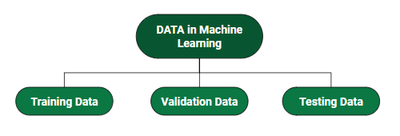
How do we split data in Machine Learning?
Training Data: The part of data we use to train our model. This is the data that your model actually sees(both input and output) and learns from.
Validation Data: The part of data that is used to do a frequent evaluation of the model, fit on the training dataset along with improving involved hyperparameters (initially set parameters before the model begins learning). This data plays its part when the model is actually training.
Testing Data: Once our model is completely trained, testing data provides an unbiased evaluation. When we feed in the inputs of Testing data, our model will predict some values(without seeing actual output). After prediction, we evaluate our model by comparing it with the actual output present in the testing data. This is how we evaluate and see how much our model has learned from the experiences feed in as training data, set at the time of training.

Slide 5
Data
Different Forms of Data
Numeric Data : If a feature represents a characteristic measured in numbers , it is called a numeric feature.
Categorical Data : A categorical feature is an attribute that can take on one of the limited , and usually fixed number of possible values on the basis of some qualitative property . A categorical feature is also called a nominal feature.
Ordinal Data : This denotes a nominal variable with categories falling in an ordered list . Examples include clothing sizes such as small, medium , and large , or a measurement of customer satisfaction on a scale from “not at all happy” to “very happy”.
Properties of Data –
Volume: Scale of Data. With the growing world population and technology at exposure, huge data is being generated each and every millisecond.
Variety: Different forms of data – healthcare, images, videos, audio clippings.
Velocity: Rate of data streaming and generation.
Value: Meaningfulness of data in terms of information that researchers can infer from it.
Veracity: Certainty and correctness in data we are working on.
Viability: The ability of data to be used and integrated into different systems and processes.
Security: The measures taken to protect data from unauthorized access or manipulation.
Accessibility: The ease of obtaining and utilizing data for decision-making purposes.
Integrity: The accuracy and completeness of data over its entire lifecycle.
Usability: The ease of use and interpretability of data for end-users.

Slide 6
Data Cleaning
Data cleaning is a crucial step in the machine learning (ML) pipeline, as it involves identifying and removing any missing, duplicate, or irrelevant data. The goal of data cleaning is to ensure that the data is accurate, consistent, and free of errors, as incorrect or inconsistent data can negatively impact the performance of the ML model. Professional data scientists usually invest a very large portion of their time in this step because of the belief that “Better data beats fancier algorithms”.
Data cleaning, also known as data cleansing or data preprocessing, is a crucial step in the data science pipeline that involves identifying and correcting or removing errors, inconsistencies, and inaccuracies in the data to improve its quality and usability. Data cleaning is essential because raw data is often noisy, incomplete, and inconsistent, which can negatively impact the accuracy and reliability of the insights derived from it.
Without proper data cleaning, inaccuracies, outliers, missing values, and inconsistencies can compromise the validity of analytical results. Moreover, clean data facilitates more effective modeling and pattern recognition, as algorithms perform optimally when fed high-quality, error-free input.
Additionally, clean datasets enhance the interpretability of findings, aiding in the formulation of actionable insights.
Steps to Perform Data Cleanliness
Removal of Unwanted Observations: Identify and eliminate irrelevant or redundant observations from the dataset. The step involves scrutinizing data entries for duplicate records, irrelevant information, or data points that do not contribute meaningfully to the analysis. Removing unwanted observations streamlines the dataset, reducing noise and improving the overall quality.
Fixing Structure errors: Address structural issues in the dataset, such as inconsistencies in data formats, naming conventions, or variable types. Standardize formats, correct naming discrepancies, and ensure uniformity in data representation. Fixing structure errors enhances data consistency and facilitates accurate analysis and interpretation.
Managing Unwanted outliers: Identify and manage outliers, which are data points significantly deviating from the norm. Depending on the context, decide whether to remove outliers or transform them to minimize their impact on analysis. Managing outliers is crucial for obtaining more accurate and reliable insights from the data.
Handling Missing Data: Devise strategies to handle missing data effectively. This may involve imputing missing values based on statistical methods, removing records with missing values, or employing advanced imputation techniques. Handling missing data ensures a more complete dataset, preventing biases and maintaining the integrity of analyses.

Slide 7
Data Pre-Processing

Slide 8
Data Pre-Processing
Most real-life datasets we encounter during our data science project development have columns of mixed data type. These datasets consist of both categorical as well as numerical columns. However, various Machine Learning models do not work with categorical data and to fit this data into the machine learning model it needs to be converted into numerical data. For example, suppose a dataset has a Gender column with categorical elements like Male and Female. These labels have no specific order of preference and also since the data is string labels, machine learning models misinterpreted that there is some sort of hierarchy in them.
One approach to solve this problem can be label encoding where we will assign a numerical value to these labels for example Male and Female mapped to 0 and 1. But this can add bias in our model as it will start giving higher preference to the Female parameter as 1>0 but ideally, both labels are equally important in the dataset. To deal with this issue we will use the One Hot Encoding technique.

Slide 9
One Hot Encoding
One hot encoding is a technique that we use to represent categorical variables as numerical values in a machine learning model.
The advantages of using one hot encoding include:
It allows the use of categorical variables in models that require numerical input.
It can improve model performance by providing more information to the model about the categorical variable.
It can help to avoid the problem of ordinality, which can occur when a categorical variable has a natural ordering (e.g. “small”, “medium”, “large”).
The disadvantages of using one hot encoding include:
It can lead to increased dimensionality, as a separate column is created for each category in the variable. This can make the model more complex and slow to train.
It can lead to sparse data, as most observations will have a value of 0 in most of the one-hot encoded columns.
It can lead to overfitting, especially if there are many categories in the variable and the sample size is relatively small.
One-hot-encoding is a powerful technique to treat categorical data, but it can lead to increased dimensionality, sparsity, and overfitting. It is important to use it cautiously and consider other methods such as ordinal encoding or binary encoding.

Slide 10
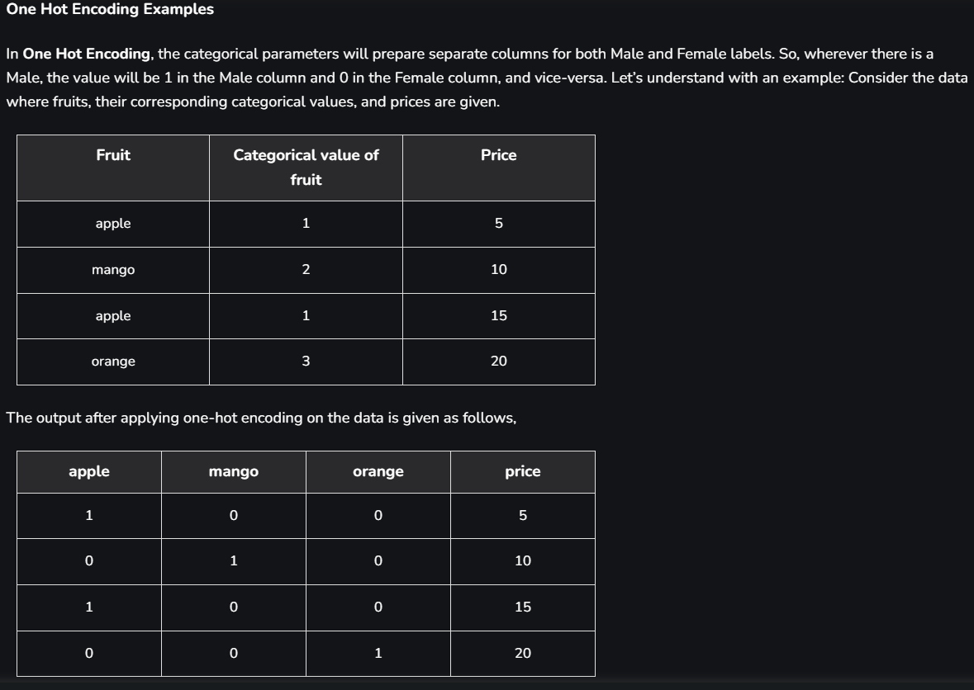
One Hot Encoding

Slide 11
Binary Encoding
Binary encoding is a technique for representing categorical variables as binary code. In this method, each category is assigned a unique binary code, with the number of bits equal to the number of unique categories in the feature. The binary code is then used to represent the category in the data.
For example, consider a categorical feature with 3 categories: “A”, “B”, and “C”. The categories can be represented as binary code as follows:
Category “A”: 00
Category “B”: 01
Category “C”: 10
Each row in the data containing the categorical feature will be replaced by the corresponding binary code.
Binary encoding can handle categorical variables with a large number of categories more efficiently than one-hot encoding, as it reduces the dimensionality of the data by representing each category with a fixed number of bits. This can also help in avoiding the curse of dimensionality, where increasing the number of features can lead to decreased performance of machine learning models.

Slide 12
Binary Encoding
Drawbacks of using binary encoding?
The drawbacks of using binary encoding for categorical variables include:
Complexity: Binary encoding can be complex to implement and understand, especially for non-technical individuals.
Ordering of categories: Binary encoding assigns binary codes to categories in a specific order, which may not always reflect the true relationship between categories. For example, if the binary encoding assigns the code “00” to the category “A” and “01” to the category “B”, this may lead to the assumption that “A” is less than “B”.
Information Loss: Binary encoding can result in information loss compared to one-hot encoding, as it reduces the number of columns representing the categorical feature. This may result in a loss of detail and decreased performance of machine learning models.
Model limitations: Some machine learning models, such as decision trees, may not be able to handle binary encoded features effectively, as they may not be able to capture the underlying relationships between categories.
Interpreting Results: Binary encoding can make it difficult to interpret the results of machine learning models, as the binary codes may not have a clear relationship to the original categories.
With binary encoding, you can reduce the dimensionality of the data by representing each category with a fixed number of bits. This can help in terms of memory usage and computational time, especially when dealing with large datasets. However, this reduction in dimensionality also means that some information about the relationships between categories may be lost. In a sense, binary encoding is somewhere between label encoding and one-hot encoding.

Slide 13
Binary Encoding
Label encoding assigns a unique integer to each category, preserving the ordinal relationships between categories but not the magnitude of those relationships. On the other hand, one-hot encoding creates a separate column for each category, capturing the magnitude of relationships but not the ordinal relationships.
In machine learning projects, we usually deal with datasets having different categorical columns where some columns have their elements in the ordinal variable category for e.g a column income level having elements as low, medium, or high in this case we can replace these elements with 1,2,3. where 1 represents ‘low’ 2 ‘medium’ and 3′ high’. Through this type of encoding, we try to preserve the meaning of the element where higher weights are assigned to the elements having higher priority.
Limitation of label Encoding: Label encoding converts the categorical data into numerical ones, but it assigns a unique number(starting from 0) to each class of data. This may lead to the generation of priority issues during model training of data sets. A label with a high value may be considered to have high priority than a label having a lower value. An attribute having output classes Mexico, Paris, Dubai. On Label Encoding, this column lets Mexico is replaced with 0, Paris is replaced with 1, and Dubai is replaced with 2.
Binary encoding, on the other hand, assigns a unique binary code to each category, preserving some information about the ordinal relationships between categories while also reducing the dimensionality of the data. It is a trade-off between the simplicity and interpretability of label encoding and the information preservation of one-hot encoding.
“Ordinal relationships” refer to the order of categories, such as “small”, “medium”, and “large”. In an ordinal relationship, the categories have a natural order or ranking, and the difference between categories is not the same.
“The magnitude of relationships” refers to the strength of the relationship between categories. For example, in a one-hot encoded representation, the presence or absence of a category in a particular row of data is used to indicate the relationship between that row and the corresponding category. The magnitude of the relationship is indicated by the presence or absence of a particular category in the data.
In summary, label encoding captures the ordinal relationships between categories, while one-hot encoding captures the magnitude of relationships. Binary encoding captures some information about both the ordinal relationships and the magnitude of relationships between categories.
Label encoding is best when there is an ordinal relationship between categories, as it captures the order of categories and can simplify the encoding process. One-hot encoding is best when there is no ordinal relationship between categories, as it captures the magnitude of relationships and provides a high-dimensional representation of the data. Binary encoding is best when there are weak ordinal relationships between categories and the magnitude of relationships is not critical, or when memory constraints prevent the use of one-hot encoding.

Slide 14
Dummy Variable Trap
The Dummy variable trap is a scenario where there are attributes that are highly correlated (Multicollinear) and one variable predicts the value of others. When we use one-hot encoding for handling the categorical data, then one dummy variable (attribute) can be predicted with the help of other dummy variables. Hence, one dummy variable is highly correlated with other dummy variables. Using all dummy variables for regression models leads to a dummy variable trap. So, the regression models should be designed to exclude one dummy variable.
For Example –
Let’s consider the case of gender having two values male (0 or 1) and female (1 or 0). Including both the dummy variable can cause redundancy because if a person is not male in such case that person is a female, hence, we don’t need to use both the variables in regression models. This will protect us from the dummy variable trap.

Slide 15
Exploratory Data Analysis (EDA)
Exploratory Data Analysis (EDA) is a crucial initial step in data science projects. It involves analyzing and visualizing data to understand its key characteristics, uncover patterns, and identify relationships between variables refers to the method of studying and exploring record sets to apprehend their predominant traits, discover patterns, locate outliers, and identify relationships between variables. EDA is normally carried out as a preliminary step before undertaking extra formal statistical analyses or modeling.
Key aspects of EDA include:
Distribution of Data: Examining the distribution of data points to understand their range, central tendencies (mean, median), and dispersion (variance, standard deviation).
Graphical Representations: Utilizing charts such as histograms, box plots, scatter plots, and bar charts to visualize relationships within the data and distributions of variables.
Outlier Detection: Identifying unusual values that deviate from other data points. Outliers can influence statistical analyses and might indicate data entry errors or unique cases.
Correlation Analysis: Checking the relationships between variables to understand how they might affect each other. This includes computing correlation coefficients and creating correlation matrices.
Handling Missing Values: Detecting and deciding how to address missing data points, whether by imputation or removal, depending on their impact and the amount of missing data.
Summary Statistics: Calculating key statistics that provide insight into data trends and nuances.
Testing Assumptions: Many statistical tests and models assume the data meet certain conditions (like normality or homoscedasticity). EDA helps verify these assumptions.

Slide 16
Exploratory Data Analysis (EDA)
Why Exploratory Data Analysis is Important?
Exploratory Data Analysis (EDA) is important for several reasons, especially in the context of data science and statistical modeling. Here are some of the key reasons why EDA is a critical step in the data analysis process:
Understanding Data Structures: EDA helps in getting familiar with the dataset, understanding the number of features, the type of data in each feature, and the distribution of data points. This understanding is crucial for selecting appropriate analysis or prediction techniques.
Identifying Patterns and Relationships: Through visualizations and statistical summaries, EDA can reveal hidden patterns and intrinsic relationships between variables. These insights can guide further analysis and enable more effective feature engineering and model building.
Detecting Anomalies and Outliers: EDA is essential for identifying errors or unusual data points that may adversely affect the results of your analysis. Detecting these early can prevent costly mistakes in predictive modeling and analysis.
Testing Assumptions: Many statistical models assume that data follow a certain distribution or that variables are independent. EDA involves checking these assumptions. If the assumptions do not hold, the conclusions drawn from the model could be invalid.
Informing Feature Selection and Engineering: Insights gained from EDA can inform which features are most relevant to include in a model and how to transform them (scaling, encoding) to improve model performance.
Optimizing Model Design: By understanding the data’s characteristics, analysts can choose appropriate modeling techniques, decide on the complexity of the model, and better tune model parameters.
Facilitating Data Cleaning: EDA helps in spotting missing values and errors in the data, which are critical to address before further analysis to improve data quality and integrity.
Enhancing Communication: Visual and statistical summaries from EDA can make it easier to communicate findings and convince others of the validity of your conclusions, particularly when explaining data-driven insights to stakeholders without technical backgrounds.

Slide 17
Exploratory Data Analysis (EDA)
Types of Exploratory Data Analysis: EDA, or Exploratory Data Analysis, refers back to the method of analyzing and analyzing information units to uncover styles, pick out relationships, and gain insights. There are various sorts of EDA strategies that can be hired relying on the nature of the records and the desires of the evaluation. Depending on the number of columns we are analyzing we can divide EDA into three types: Univariate, bivariate and multivariate.
Univariate Analysis: focuses on a single variable to understand its internal structure. It is primarily concerned with describing the data and finding patterns existing in a single feature. This sort of evaluation makes a speciality of analyzing character variables inside the records set. It involves summarizing and visualizing a unmarried variable at a time to understand its distribution, relevant tendency, unfold, and different applicable records. Common techniques include:
Histograms: Used to visualize the distribution of a variable.
Box plots: Useful for detecting outliers and understanding the spread and skewness of the data.
Bar charts: Employed for categorical data to show the frequency of each category.
Summary statistics: Calculations like mean, median, mode, variance, and standard deviation that describe the central tendency and dispersion of the data.

Slide 18
Exploratory Data Analysis (EDA)
Bivariate Analysis: Bivariate evaluation involves exploring the connection between variables. It enables find associations, correlations, and dependencies between pairs of variables. Bivariate analysis is a crucial form of exploratory data analysis that examines the relationship between two variables. Some key techniques used in bivariate analysis:
Scatter Plots: These are one of the most common tools used in bivariate analysis. A scatter plot helps visualize the relationship between two continuous variables.
Correlation Coefficient: This statistical measure (often Pearson’s correlation coefficient for linear relationships) quantifies the degree to which two variables are related.
Cross-tabulation: Also known as contingency tables, cross-tabulation is used to analyze the relationship between two categorical variables. It shows the frequency distribution of categories of one variable in rows and the other in columns, which helps in understanding the relationship between the two variables.
Line Graphs: In the context of time series data, line graphs can be used to compare two variables over time. This helps in identifying trends, cycles, or patterns that emerge in the interaction of the variables over the specified period.
Covariance: Covariance is a measure used to determine how much two random variables change together. However, it is sensitive to the scale of the variables, so it’s often supplemented by the correlation coefficient for a more standardized assessment of the relationship.
Multivariate Analysis: examines the relationships between two or more variables in the dataset. It aims to understand how variables interact with one another, which is crucial for most statistical modeling techniques. Techniques include:
Pair plots: Visualize relationships across several variables simultaneously to capture a comprehensive view of potential interactions.
Principal Component Analysis (PCA): A dimensionality reduction technique used to reduce the dimensionality of large datasets, while preserving as much variance as possible.
Specialized EDA Techniques
In addition to univariate and multivariate analysis, there are specialized EDA techniques tailored for specific types of data or analysis needs:
Spatial Analysis: For geographical data, using maps and spatial plotting to understand the geographical distribution of variables.
Text Analysis: Involves techniques like word clouds, frequency distributions, and sentiment analysis to explore text data.
Time Series Analysis: This type of analysis is mainly applied to statistics sets that have a temporal component. Time collection evaluation entails inspecting and modeling styles, traits, and seasonality inside the statistics through the years. Techniques like line plots, autocorrelation analysis, transferring averages, and ARIMA (AutoRegressive Integrated Moving Average) fashions are generally utilized in time series analysis.

Slide 19
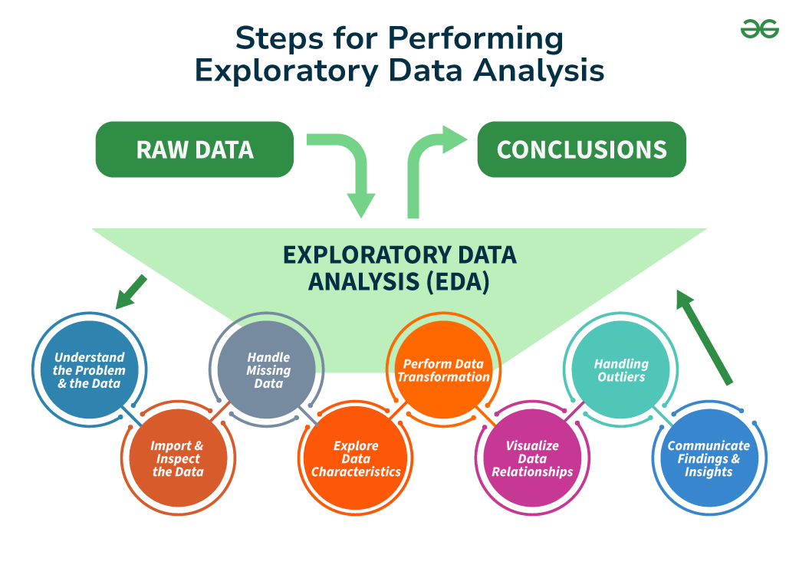
Exploratory Data Analysis (EDA)
Steps for Performing Exploratory Data Analysis
Performing Exploratory Data Analysis (EDA) involves a series of steps designed to help you understand the data you’re working with, uncover underlying patterns, identify anomalies, test hypotheses, and ensure the data is clean and suitable for further analysis.
Step 1: Understand the Problem and the Data
The first step in any information evaluation project is to sincerely apprehend the trouble you are trying to resolve and the statistics you have at your disposal. This entails asking questions consisting of:
What is the commercial enterprise goal or research question you are trying to address?
What are the variables inside the information, and what do they mean?
What are the data sorts (numerical, categorical, textual content, etc.) ?
Is there any known information on first-class troubles or obstacles?
Are there any relevant area-unique issues or constraints?
By thoroughly knowing the problem and the information, you can better formulate your evaluation technique and avoid making incorrect assumptions or drawing misguided conclusions. It is also vital to contain situations and remember specialists or stakeholders to this degree to ensure you have complete know-how of the context and requirements.

Slide 20
Exploratory Data Analysis (EDA)
Step 2: Import and Inspect the Data
Once you have clean expertise of the problem and the information, the following step is to import the data into your evaluation environment (e.g., Python, R, or a spreadsheet program). During this step, looking into the statistics is critical to gain initial know-how of its structure, variable kinds, and capability issues.
Here are a few obligations you could carry out at this stage:
Load the facts into your analysis environment, ensuring that the facts are imported efficiently and without errors or truncations.
Examine the size of the facts (variety of rows and columns) to experience its length and complexity.
Check for missing values and their distribution across variables, as missing information can notably affect the quality and reliability of your evaluation.
Identify facts sorts and formats for each variable, as these records may be necessary for the following facts manipulation and evaluation steps.
Look for any apparent errors or inconsistencies in the information, such as invalid values, mismatched units, or outliers, that can indicate exceptional issues with information.

Slide 21
Exploratory Data Analysis (EDA)
Step 3: Handle Missing Data
Missing records is a joint project in many datasets, and it can significantly impact the quality and reliability of your evaluation. During the EDA method, it’s critical to pick out and deal with lacking information as it should be, as ignoring or mishandling lacking data can result in biased or misleading outcomes.
Here are some techniques you could use to handle missing statistics:
Understand the styles and capacity reasons for missing statistics: Is the information lacking entirely at random (MCAR), lacking at random (MAR), or lacking not at random (MNAR)? Understanding the underlying mechanisms can inform the proper method for handling missing information.
Decide whether to eliminate observations with lacking values (listwise deletion) or attribute (fill in) missing values: Removing observations with missing values can result in a loss of statistics and potentially biased outcomes, specifically if the lacking statistics are not MCAR. Imputing missing values can assist in preserving treasured facts. However, the imputation approach needs to be chosen cautiously.
Use suitable imputation strategies, such as mean/median imputation, regression imputation, a couple of imputations, or device-getting-to-know-based imputation methods like k-nearest associates (KNN) or selection trees. The preference for the imputation technique has to be primarily based on the characteristics of the information and the assumptions underlying every method.
Consider the effect of lacking information: Even after imputation, lacking facts can introduce uncertainty and bias. It is important to acknowledge those limitations and interpret your outcomes with warning.
Handling missing information nicely can improve the accuracy and reliability of your evaluation and save you biased or deceptive conclusions. It is likewise vital to record the techniques used to address missing facts and the motive in the back of your selection

Slide 22
Exploratory Data Analysis (EDA)
Step 4: Explore Data Characteristics
After addressing the facts that are lacking, the next step within the EDA technique is to explore the traits of your statistics. This entails examining your variables’ distribution, crucial tendency, and variability and identifying any ability outliers or anomalies. Understanding the characteristics of your information is critical in deciding on appropriate analytical techniques, figuring out capability information first-rate troubles, and gaining insights that may tell subsequent evaluation and modeling decisions.
Calculate summary facts (suggest, median, mode, preferred deviation, skewness, kurtosis, and many others.) for numerical variables: These facts provide a concise assessment of the distribution and critical tendency of each variable, aiding in the identification of ability issues or deviations from expected patterns.
Step 5: Perform Data Transformation
Data transformation is a critical step within the EDA process because it enables you to prepare your statistics for similar evaluation and modeling. Depending on the traits of your information and the necessities of your analysis, you may need to carry out various ameliorations to ensure that your records are in the most appropriate layout.
Here are a few common records transformation strategies:
Scaling or normalizing numerical variables to a standard variety (e.g., min-max scaling, standardization)
Encoding categorical variables to be used in machine mastering fashions (e.g., one-warm encoding, label encoding)
Applying mathematical differences to numerical variables (e.g., logarithmic, square root) to correct for skewness or non-linearity
Creating derived variables or capabilities primarily based on current variables (e.g., calculating ratios, combining variables)
Aggregating or grouping records mainly based on unique variables or situations
By accurately transforming your information, you could ensure that your evaluation and modeling strategies are implemented successfully and that your results are reliable and meaningful.

Slide 23
Exploratory Data Analysis (EDA)
Step 6: Visualize Data Relationships
Visualization is an effective tool in the EDA manner, as it allows to discover relationships between variables and become aware of styles or trends that may not immediately be apparent from summary statistics or numerical outputs. To visualize data relationships, explore univariate, bivariate, and multivariate analysis.
Create frequency tables, bar plots, and pie charts for express variables: These visualizations can help you apprehend the distribution of classes and discover any ability imbalances or unusual patterns.
Generate histograms, container plots, violin plots, and density plots to visualize the distribution of numerical variables. These visualizations can screen critical information about the form, unfold, and ability outliers within the statistics.
Examine the correlation or association among variables using scatter plots, correlation matrices, or statistical assessments like Pearson’s correlation coefficient or Spearman’s rank correlation: Understanding the relationships between variables can tell characteristic choice, dimensionality discount, and modeling choices.
Step 7: Handling Outliers
An Outlier is a data item/object that deviates significantly from the rest of the (so-called normal)objects. They can be caused by measurement or execution errors. The analysis for outlier detection is referred to as outlier mining. There are many ways to detect outliers, and the removal process of these outliers from the dataframe is the same as removing a data item from the panda’s dataframe.
Identify and inspect capability outliers through the usage of strategies like the interquartile range (IQR), Z-scores, or area-specific regulations: Outliers can considerably impact the results of statistical analyses and gadget studying fashions, so it’s essential to perceive and take care of them as it should be.

Slide 24
Exploratory Data Analysis (EDA)
Step 8: Communicate Findings and Insights
The final step in the EDA technique is effectively discussing your findings and insights. This includes summarizing your evaluation, highlighting fundamental discoveries, and imparting your outcomes cleanly and compellingly.
Here are a few hints for effective verbal exchange:
Clearly state the targets and scope of your analysis
Provide context and heritage data to assist others in apprehending your approach
Use visualizations and photos to guide your findings and make them more reachable
Highlight critical insights, patterns, or anomalies discovered for the duration of the EDA manner
Discuss any barriers or caveats related to your analysis
Suggest ability next steps or areas for additional investigation
Effective conversation is critical for ensuring that your EDA efforts have a meaningful impact and that your insights are understood and acted upon with the aid of stakeholders.

Slide 25
Exploratory Data Analysis (EDA)
Step 8: Communicate Findings and Insights
The final step in the EDA technique is effectively discussing your findings and insights. This includes summarizing your evaluation, highlighting fundamental discoveries, and imparting your outcomes cleanly and compellingly.
Here are a few hints for effective verbal exchange:
Clearly state the targets and scope of your analysis
Provide context and heritage data to assist others in apprehending your approach
Use visualizations and photos to guide your findings and make them more reachable
Highlight critical insights, patterns, or anomalies discovered for the duration of the EDA manner
Discuss any barriers or caveats related to your analysis
Suggest ability next steps or areas for additional investigation
Effective conversation is critical for ensuring that your EDA efforts have a meaningful impact and that your insights are understood and acted upon with the aid of stakeholders.

Slide 26
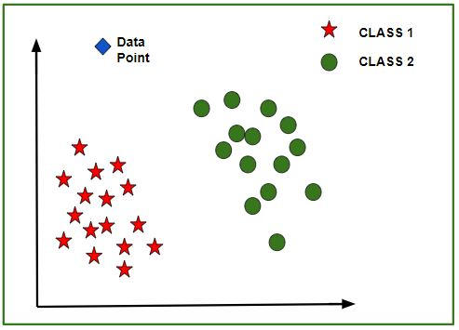
Feature Scaling
Given a data-set with features- Age, Salary, BHK Apartment with the data size of 5000 people, each having these independent data features.
Each data point is labeled as:
Class1- YES (means with the given Age, Salary, BHK Apartment feature value one can buy the property)
Class2- NO (means with the given Age, Salary, BHK Apartment feature value one can’t buy the property).
Using a dataset to train the model, one aims to build a model that can predict whether one can buy a property or not with given feature values.
Now a new data point (diamond as shown in the figure) is given and it has different independent values for the 3 features (Age, Salary, BHK Apartment) mentioned above. The model has to predict whether this data point belongs to Yes or No.

Slide 27
Feature Scaling
Need of Feature Scaling:
The given data set contains 3 features – Age, Salary, BHK Apartment. Consider a range of 10- 60 for Age, 1 Lac- 40 Lacs for Salary, 1- 5 for BHK of Flat. All these features are independent of each other.
Suppose the centroid of class 1 is [40, 22 Lacs, 3] and the data point to be predicted is [57, 33 Lacs, 2].
Using Manhattan Method,
Distance = (|(40 - 57)| + |(2200000 - 3300000)| + |(3 - 2)|)
It can be seen that the Salary feature will dominate all other features while predicting the class of the given data point and since all the features are independent of each other i.e. a person’s salary has no relation with his/her age or what requirement of the flat he/she has. This means that the model will always predict wrong.
So, the simple solution to this problem is Feature Scaling. Feature Scaling Algorithms will scale Age, Salary, BHK in a fixed range say [-1, 1] or [0, 1]. And then no feature can dominate others.
What is Feature Scaling?
Feature Scaling is a technique to standardize the independent features present in the data in a fixed range. It is performed during the data pre-processing to handle highly varying magnitudes or values or units. If feature scaling is not done, then a machine learning algorithm tends to weigh greater values, higher and consider smaller values as the lower values, regardless of the unit of the values.

Slide 28
Feature Scaling
Why use Feature Scaling?
In machine learning, feature scaling is employed for a number of purposes:
Scaling guarantees that all features are on a comparable scale and have comparable ranges. This process is known as feature normalisation. This is significant because the magnitude of the features has an impact on many machine learning techniques. Larger scale features may dominate the learning process and have an excessive impact on the outcomes. You can avoid this problem and make sure that each feature contributes equally to the learning process by scaling the features.
Algorithm performance improvement: When the features are scaled, several machine learning methods, including gradient descent-based algorithms, distance-based algorithms (such k-nearest neighbours), and support vector machines, perform better or converge more quickly. The algorithm’s performance can be enhanced by scaling the features, which can hasten the convergence of the algorithm to the ideal outcome.
Preventing numerical instability: Numerical instability can be prevented by avoiding significant scale disparities between features. Examples include distance calculations or matrix operations, where having features with radically differing scales can result in numerical overflow or underflow problems. Stable computations are ensured and these issues are mitigated by scaling the features.
Scaling features makes ensuring that each characteristic is given the same consideration during the learning process. Without scaling, bigger scale features could dominate the learning, producing skewed outcomes. This bias is removed through scaling, which also guarantees that each feature contributes fairly to model predictions.

Slide 29
Feature Scaling
Absolute Maximum Scaling
This method of scaling requires two-step:
We should first select the maximum absolute value out of all the entries of a particular measure.
Then after this, we divide each entry of the column by this maximum value.
After performing the above-mentioned two steps we will observe that each entry of the column lies in the range of -1 to 1. But this method is not used that often the reason behind this is that it is too sensitive to the outliers. And while dealing with the real-world data presence of outliers is a very common thing.
Min-Max Scaling
This method of scaling requires below two-step:
First, we are supposed to find the minimum and the maximum value of the column.
Then we will subtract the minimum value from the entry and divide the result by the difference between the maximum and the minimum value.
As we are using the maximum and the minimum value this method is also prone to outliers but the range in which the data will range after performing the above two steps is between 0 to 1.

Slide 30
Feature Scaling
Normalization
This method is more or less the same as the previous method but here instead of the minimum value, we subtract each entry by the mean value of the whole data and then divide the results by the difference between the minimum and the maximum value.
Standardization
This method of scaling is basically based on the central tendencies and variance of the data.
First, we should calculate the mean and standard deviation of the data we would like to normalize.
Then we are supposed to subtract the mean value from each entry and then divide the result by the standard deviation.
This helps us achieve a normal distribution(if it is already normal but skewed) of the data with a mean equal to zero and a standard deviation equal to 1.
Robust Scaling
In this method of scaling, we use two main statistical measures of the data.
Median
Inter-Quartile Range
After calculating these two values we are supposed to subtract the median from each entry and then divide the result by the interquartile range.

Slide 31
Imbalanced Data

Slide 32
Imbalanced Data
In Machine Learning and Data Science we often come across a term called Imbalanced Data Distribution, generally happens when observations in one of the class are much higher or lower than the other classes. As Machine Learning algorithms tend to increase accuracy by reducing the error, they do not consider the class distribution. This problem is prevalent in examples such as Fraud Detection, Anomaly Detection, Facial recognition etc. Standard ML techniques such as Decision Tree and Logistic Regression have a bias towards the majority class, and they tend to ignore the minority class. They tend only to predict the majority class, hence, having major misclassification of the minority class in comparison with the majority class. In more technical words, if we have imbalanced data distribution in our dataset then our model becomes more prone to the case when minority class has negligible or very lesser recall.
Imbalanced Data Handling Techniques: There are mainly 2 mainly algorithms that are widely used for handling imbalanced class distribution.
SMOTE
Near Miss Algorithm

Slide 33
SMOTE (Synthetic Minority Oversampling Technique) – Oversampling
SMOTE (synthetic minority oversampling technique) is one of the most commonly used oversampling methods to solve the imbalance problem. It aims to balance class distribution by randomly increasing minority class examples by replicating them. SMOTE synthesises new minority instances between existing minority instances. It generates the virtual training records by linear interpolation for the minority class. These synthetic training records are generated by randomly selecting one or more of the k-nearest neighbors for each example in the minority class. After the oversampling process, the data is reconstructed and several classification models can be applied for the processed data. More Deep Insights of how SMOTE Algorithm work !
Step 1: Setting the minority class set A, for each [Tex]$x \in A$[/Tex], the k-nearest neighbors of x are obtained by calculating the Euclidean distance between x and every other sample in set A.
Step 2: The sampling rate N is set according to the imbalanced proportion. For each [Tex]$x \in A$[/Tex], N examples (i.e x1, x2, …xn) are randomly selected from its k-nearest neighbors, and they construct the set [Tex]$A_1$[/Tex] .
Step 3: For each example [Tex]$x_k \in A_1$[/Tex] (k=1, 2, 3…N), the following formula is used to generate a new example: [Tex]$x’ = x + rand(0, 1) * \mid x – x_k \mid$[/Tex] in which rand(0, 1) represents the random number between 0 and 1.

Slide 34
NearMiss Algorithm – Undersampling
NearMiss is an under-sampling technique. It aims to balance class distribution by randomly eliminating majority class examples. When instances of two different classes are very close to each other, we remove the instances of the majority class to increase the spaces between the two classes. This helps in the classification process. To prevent problem of information loss in most under-sampling techniques, near-neighbor methods are widely used. The basic intuition about the working of near-neighbor methods is as follows:
Step 1: The method first finds the distances between all instances of the majority class and the instances of the minority class. Here, majority class is to be under-sampled.
Step 2: Then, n instances of the majority class that have the smallest distances to those in the minority class are selected.
Step 3: If there are k instances in the minority class, the nearest method will result in k*n instances of the majority class.
For finding n closest instances in the majority class, there are several variations of applying NearMiss Algorithm :
NearMiss – Version 1 : It selects samples of the majority class for which average distances to the k closest instances of the minority class is smallest.
NearMiss – Version 2 : It selects samples of the majority class for which average distances to the k farthest instances of the minority class is smallest.
NearMiss – Version 3 : It works in 2 steps. Firstly, for each minority class instance, their M nearest-neighbors will be stored. Then finally, the majority class instances are selected for which the average distance to the N nearest-neighbors is the largest.

Slide 35
Curse of dimensionality
Features are number of columns or dimensions that we have in our dataset
Increasing dimensionality of features increases the data requirements exponentially.
For example, if a single feature can be accurately approximated with 100 data points, to optimize the joint over two features requires 100*100 data points.
Representation is also difficult

Slide 36
Generalization
Components of generalization error
Bias: how much the average model over all training sets differ from the true model?
Error due to inaccurate assumptions/simplifications made by the model
Variance: how much models estimated from different training sets differ from each other
Underfitting: model is too “simple” to represent all the relevant class characteristics
High bias and low variance
High training error and high test error
Overfitting: model is too “complex” and fits irrelevant characteristics (noise) in the data
Low bias and high variance
Low training error and high test error
Slide credit: L. Lazebnik

Slide 37
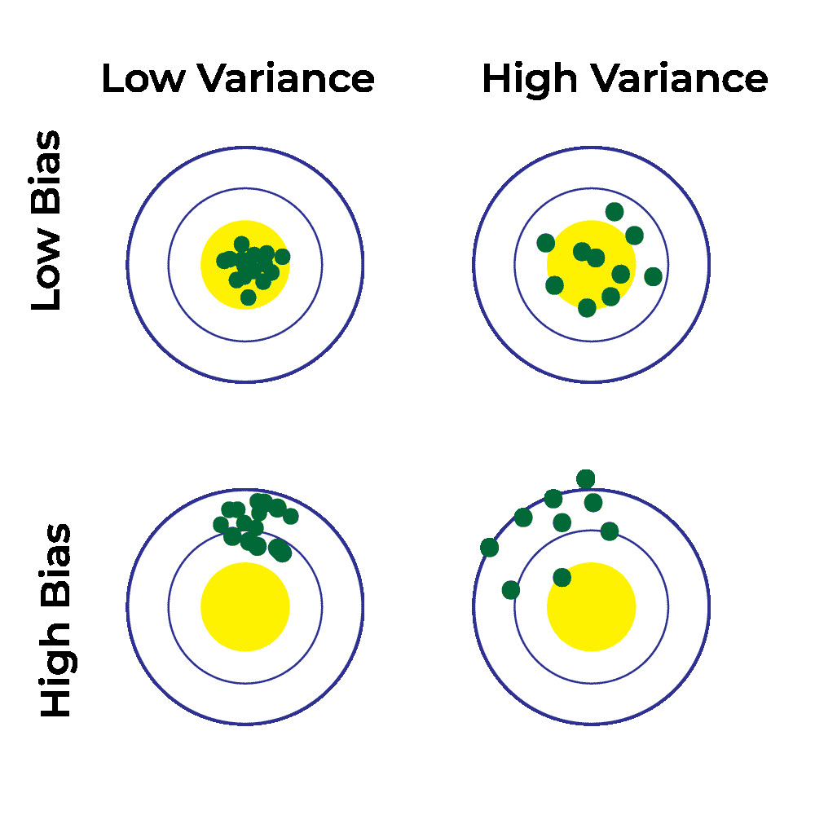
Generalization
High Bias and High Variance: model is not able to capture the underlying patterns in data (high bias) and it is also too sensitive to changes in training data) (high variance)
Low Bias and Low Variance: ideal model
Slide credit: L. Lazebnik

Slide 38
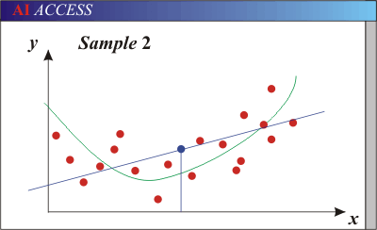
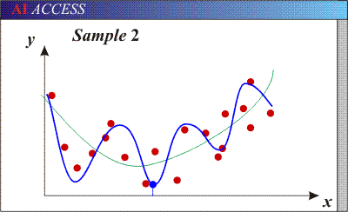
Bias-Variance Trade-off
Models with too few parameters are inaccurate because of a large bias (not enough flexibility).
Models with too many parameters are inaccurate because of a large variance (too much sensitivity to the sample).
Slide credit: D. Hoiem
Notes:
http://www.aiaccess.net/English/Glossaries/GlosMod/e_gm_bias_variance.htm

Slide 39
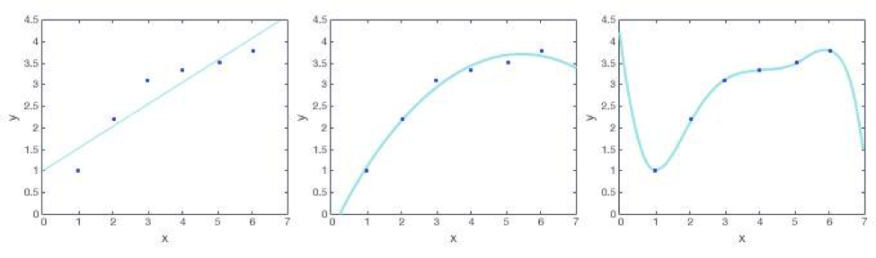
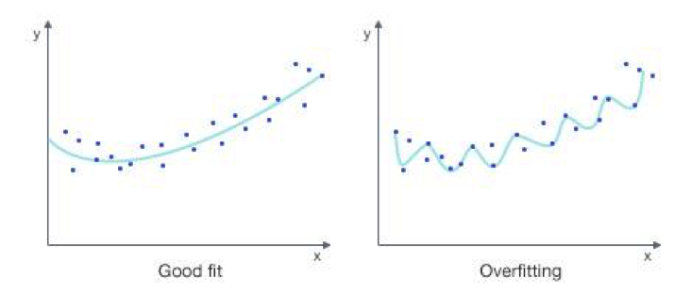

Slide 40
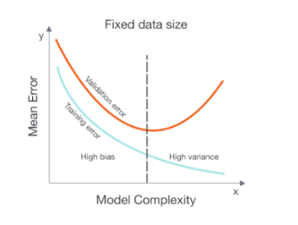
how do we know when we are overfitting the data?
Underfitting – Both validation error and training error are high
Overfitting – Validation error is high while training error is low
Good fit – Validation error is low, and only slightly higher than the training error

Slide 41
Bias-variance tradeoff
Underfitting
Overfitting
Error
Test error
Training error
High Bias
Low Variance
Complexity
Low Bias
High Variance
Slide credit: D. Hoiem

Slide 42
Bias-variance tradeoff
Few training examples
Test Error
Many training examples
High Bias
Low Variance
Complexity
Low Bias
High Variance
Slide credit: D. Hoiem
Notes:
Note: these figures don’t work in pdf

Slide 43
Effect of Training Size
Fixed prediction model
Error
Testing
Generalization Error
Training
Number of Training Examples
Slide credit: D. Hoiem

Slide 44
The perfect classification algorithm
Objective function: encodes the right loss for the problem
Parameterization: makes assumptions that fit the problem
Regularization: right level of regularization for amount of training data
Training algorithm: can find parameters that maximize objective on training set
Inference algorithm: can solve for objective function in evaluation
Slide credit: D. Hoiem

Slide 45
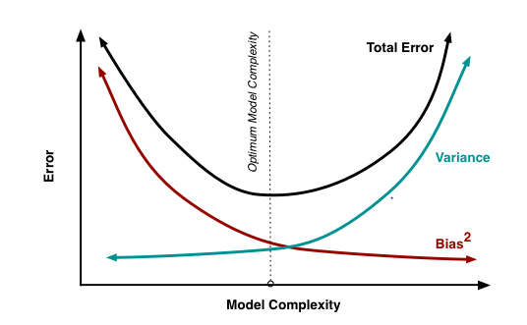
There is no escaping the relationship between bias and variance in machine learning.
Increasing the bias will decrease the variance.
Increasing the variance will decrease the bias.

Slide 46
How to reduce variance & bias?
Always Cross-Validate the model to find if it has high variance or high bias or both
Variance:
Choose a simpler classifier
Regularize (L1 & L2) the parameters
Get more training data
Feature selection (choosing only relevant features will decrease model complexity thereby lowering variance)
Ensemble Methods (Use several simple models to improve generalization and accuracy)
Early stopping the model before it overfits
Bias:
Try a larger set of features which increases the complexity of the model thereby improving it’s ability to capture underlying patterns
Choose a complex model
Lower regularization strength
Get more training data (helps model to make right assumptions when we have more data)
Slide credit: D. Hoiem
Notes:
The simpler classifier or regularization could increase bias and lead to more error.

Slide 47
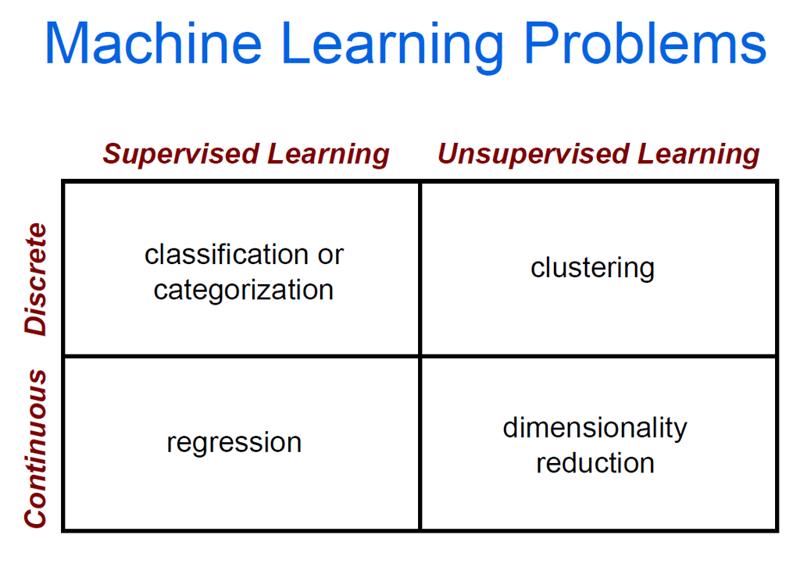

Slide 48

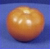
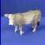
The machine learning framework
Apply a prediction function to a feature representation of the image to get the desired output:
f( ) = “apple”
f( ) = “tomato”
f( ) = “cow”
Slide credit: L. Lazebnik

Slide 49
The machine learning framework
y = f(x)
Training: given a training set of labeled examples {(x₁,y₁), …, (x_{N},y_{N})}, estimate the prediction function f by minimizing the prediction error on the training set
Testing: apply f to a never before seen test example x and output the predicted value y = f(x)
output
prediction function
Image feature
Slide credit: L. Lazebnik

Slide 50


Steps
Training
Training Labels
Training Images
Image Features
Training
Learned model
Testing
Image Features
Learned model
Prediction
Test Image
Slide credit: D. Hoiem and L. Lazebnik

Slide 51
Many classifiers to choose from
Which is the best one?
SVM
Neural networks
Naïve Bayes
Bayesian network
Logistic regression
Randomized Forests
Boosted Decision Trees
K-nearest neighbor
RBMs
Etc.
Slide credit: D. Hoiem

Slide 52
Classification measures
Accuracy is one of the measure (error = 1-accuracy).
Accuracy is not suitable in some applications.
In classification involving skewed or highly imbalanced data, e.g., network intrusion and financial fraud detections, we are interested only in the minority class.
High accuracy does not mean any intrusion is detected.
E.g., 1% intrusion. Achieve 99% accuracy by doing nothing.
The class of interest is commonly called the positive class, and the rest negative classes.

Slide 53
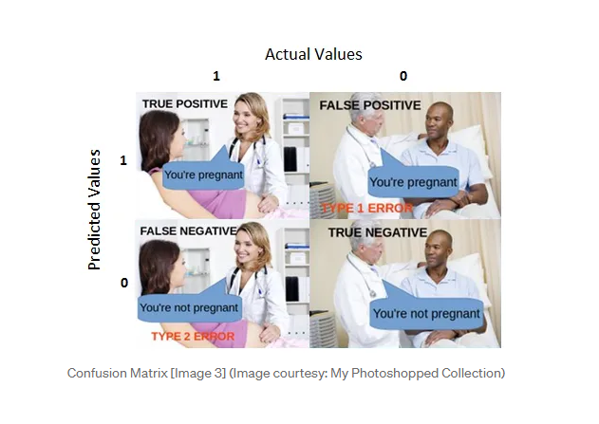
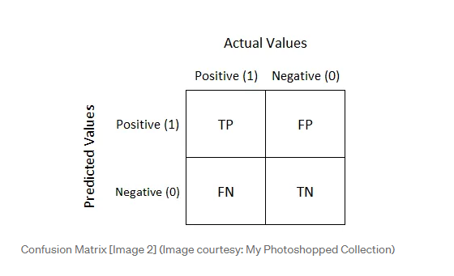
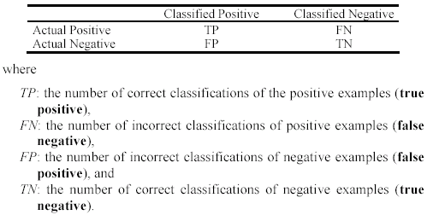
Precision and recall measures
Used in information retrieval and text classification.
We use a confusion matrix to introduce them.
Be careful with how you write confusion matrix. Some people prefer actual at top and predicted on left and some people prefer other way around

Slide 54
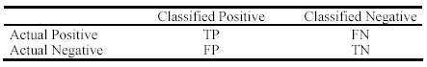
Precision and recall measures (cont…)
Precision p is the number of correctly classified positive examples divided by the total number of examples that are classified as positive. Essentially precision tells us about how many predicted positives are actually positive.
Recall r is the number of correctly classified positive examples divided by the total number of actual positive examples in the test set. Essentially recall tells us about how many actual positives are predicted positive.

Slide 55
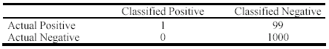
An example
This confusion matrix gives
precision p = 100% and
recall r = 1%
because we only classified one positive example correctly and no negative examples wrongly.
Note: precision and recall only measure classification on the positive class.

Slide 56
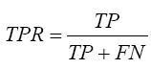
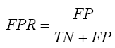
Receive operating characteristics curve
It is commonly called the ROC curve.
It is a plot of the true positive rate (TPR) against the false positive rate (FPR).
True positive rate:
False positive rate:

Slide 57
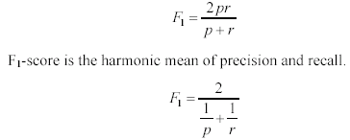
F₁-value (also called F₁-score)
It is hard to compare two classifiers using two measures. F₁ score combines precision and recall into one measure
The harmonic mean of two numbers tends to be closer to the smaller of the two.
For F₁-value to be large, both p and r much be large.

Slide 58
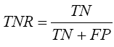
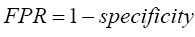
Sensitivity and Specificity
In statistics, there are two other evaluation measures:
Sensitivity: Same as TPR
Specificity: Also called True Negative Rate (TNR)
Then we have

Slide 59
Linear Regression

Slide 60
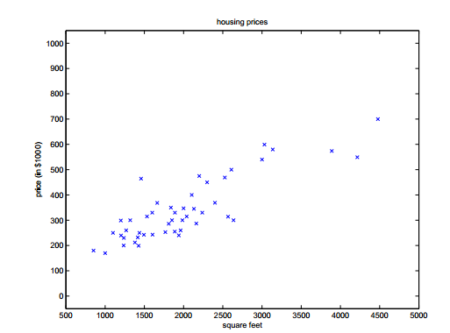
Definition
Output is Linear Combination of input variables,
W1, w2…..wp=coefficients
W0=bias or intercept
Linear Regression is used for Continuous output
values
In the figure shown, we need to fit a line passing
through the points

Slide 61
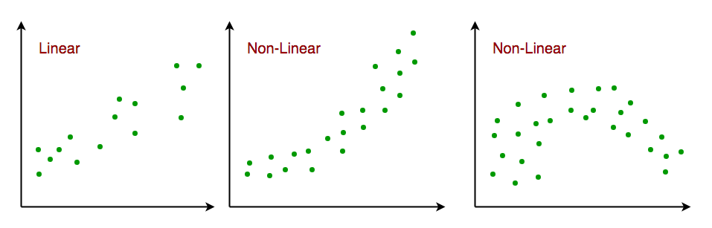
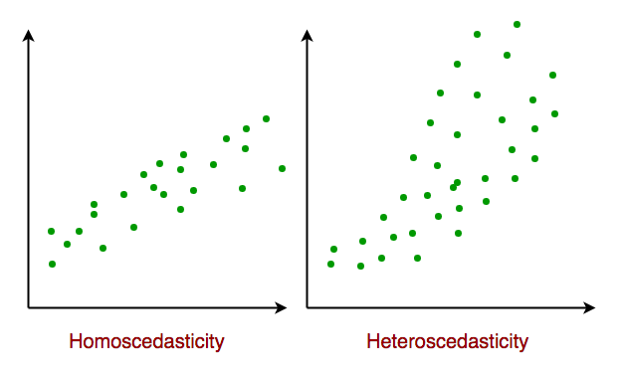
Assumptions We Make in a Linear Regression Model:
Linear relationship: The relationship between response and feature variables should be linear.
Little or no multi-collinearity: It is assumed that there is little or no multicollinearity in the data. Multicollinearity occurs when the features (or independent variables) are not independent of each other.
Little or no autocorrelation: Another assumption is that there is little or no autocorrelation in the data. Autocorrelation occurs when the residual errors are not independent of each other.
No outliers: We assume that there are no outliers in the data. Outliers are data points that are far away from the rest of the data. Outliers can affect the results of the analysis.
Homoscedasticity: Constant variance of the errors should be maintained. Homoscedasticity describes a situation in which the error term (that is, the “noise” or random disturbance in the relationship between the independent variables and the dependent variable) is the same across all values of the independent variables. As shown below, figure 1 has homoscedasticity while Figure 2 has heteroscedasticity.
Multivariate normality: Multiple Regression assumes that the residuals are normally distributed.

Slide 62
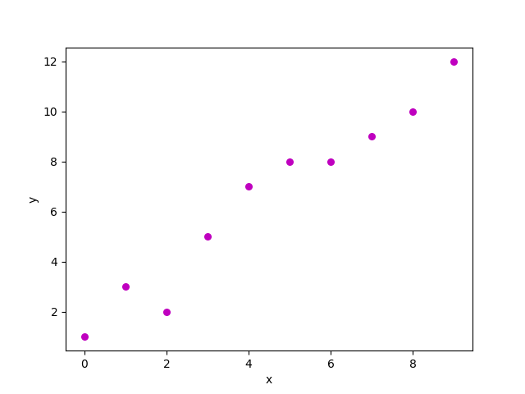
Types of Linear Regression
There are two main types of linear regression:
Simple linear regression: This involves predicting a dependent variable based on a single independent variable.
Multiple linear regression: This involves predicting a dependent variable based on multiple independent variables.
Simple linear regression: is an approach for predicting a response using a single feature. It is one of the most basic machine learning models that a machine learning enthusiast gets to know about. In linear regression, we assume that the two variables i.e. dependent and independent variables are linearly related. Hence, we try to find a linear function that predicts the response value(y) as accurately as possible as a function of the feature or independent variable(x). Let us consider a dataset where we have a value of response y for every feature x:
Multiple linear regression: attempts to model the relationship between two or more features and a response by fitting a linear equation to the observed data. Clearly, it is nothing but an extension of simple linear regression. Consider a dataset with p features(or independent variables) and one response(or dependent variable).

Slide 63
Applications of Linear Regression
Trend lines: A trend line represents the variation in quantitative data with the passage of time (like GDP, oil prices, etc.). These trends usually follow a linear relationship. Hence, linear regression can be applied to predict future values. However, this method suffers from a lack of scientific validity in cases where other potential changes can affect the data.
Economics: Linear regression is the predominant empirical tool in economics. For example, it is used to predict consumer spending, fixed investment spending, inventory investment, purchases of a country’s exports, spending on imports, the demand to hold liquid assets, labor demand, and labor supply.
Finance: The capital price asset model uses linear regression to analyze and quantify the systematic risks of an investment.
Biology: Linear regression is used to model causal relationships between parameters in biological systems.

Slide 64
Linear Regression Pros & Cons
Advantages of Linear Regression
Easy to interpret: The coefficients of a linear regression model represent the change in the dependent variable for a one-unit change in the independent variable, making it simple to comprehend the relationship between the variables.
Robust to outliers: Linear regression is relatively robust to outliers meaning it is less affected by extreme values of the independent variable compared to other statistical methods.
Can handle both linear and nonlinear relationships: Linear regression can be used to model both linear and nonlinear relationships between variables. This is because the independent variable can be transformed before it is used in the model.
No need for feature scaling or transformation: Unlike some machine learning algorithms, linear regression does not require feature scaling or transformation. This can be a significant advantage, especially when dealing with large datasets.
Disadvantages of Linear Regression
Assumes linearity: Linear regression assumes that the relationship between the independent variable and the dependent variable is linear. This assumption may not be valid for all data sets. In cases where the relationship is nonlinear, linear regression may not be a good choice.
Sensitive to multicollinearity: Linear regression is sensitive to multicollinearity. This occurs when there is a high correlation between the independent variables. Multicollinearity can make it difficult to interpret the coefficients of the model and can lead to overfitting.
May not be suitable for highly complex relationships: Linear regression may not be suitable for modeling highly complex relationships between variables. For example, it may not be able to model relationships that include interactions between the independent variables.
Not suitable for classification tasks: Linear regression is a regression algorithm and is not suitable for classification tasks, which involve predicting a categorical variable rather than a continuous variable.

Slide 65
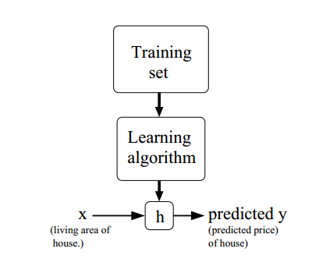

Slide 66
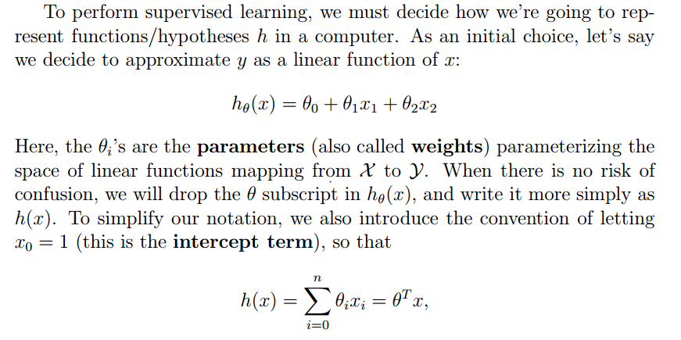

Slide 67
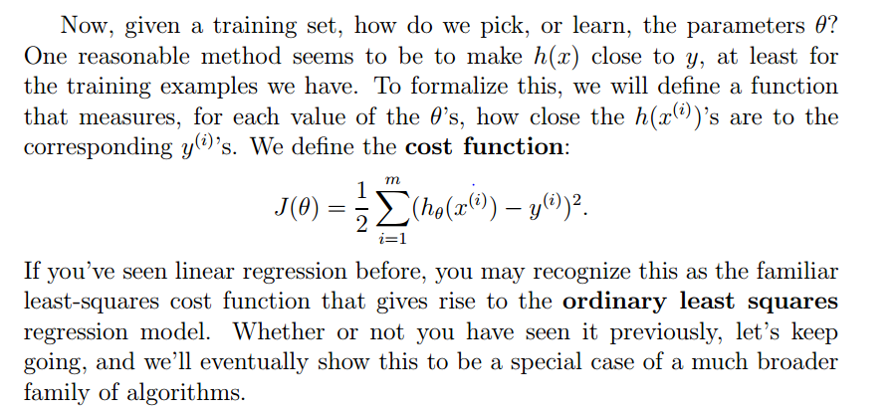

Slide 68
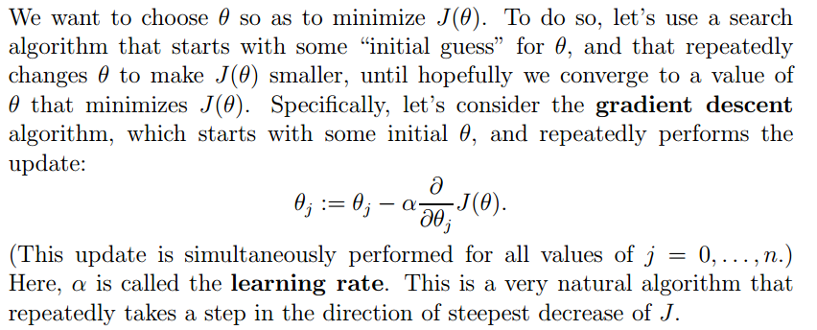
Least Mean Square(LMS) regression Model

Slide 69
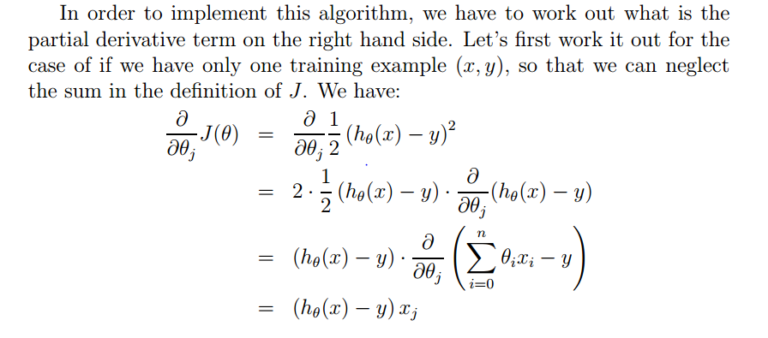
Least Mean Square(LMS) regression Model

Slide 70
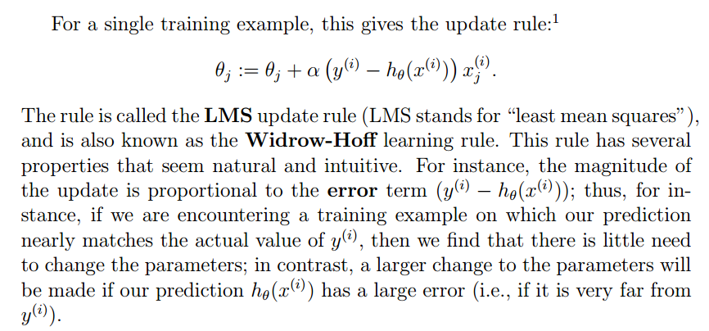
Least Mean Square(LMS) regression Model

Slide 71
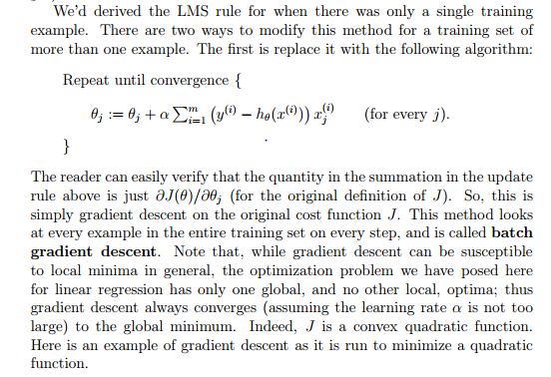

Slide 72
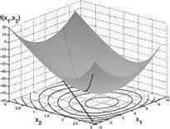
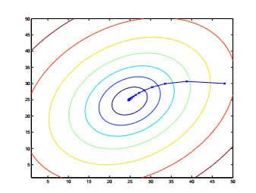
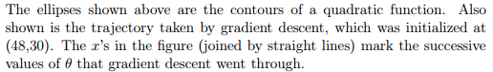
Convex Optimization using gradient descent

Slide 73
Make a guess? What does it mean?...
Hypothesis /guess :
weights
Notes:
But what it actually means… to make a guess?
Guess that we were making in the simplest case is a line.
As you know from the high school, a straight line is represented as a function f(x) = ax + b.
To draw the random guess line we need to know at least two points to draw it through.
So to make a guess literally means to choose two random points we are going to draw the line through. That is the simplest case
If we have N input parameters or predictors we’d have to think of N random values to make a guess.
This random values we’ll can theta parameters, they are also called weights.

Slide 74
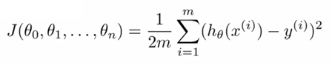
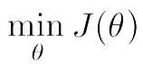
Find out our mistake…
Cost function/ Mistake function:
Gradient Descent to find the global minimum.
… and minimize it:
Notes:
Now we have training data and we have a guess that we’ve made.
Now the goal is to measure how wrong we are and what is the mistake.
How can we do it? We can, because for training data we have both inputs and already known outputs for them.
What we can do now is to send out inputs from the training set to our guess function that we’ve made and …
… to compare the output of the guess function and the actual known output that we have for the given data sample from the training set.
To compare it we are defining our COST function or MISTAKE function
It is defined as the squared error function that, for each data sample from the training data finds the difference between the guess and the output.
Basically, what the mistake function gives to us?
It shows how wrong our randomly selected weights or theta parameters are..
What are we going to do with the mistake? We want to reduce the mistake in our guess!
To reduce the mistake we should minimize our mistake function
We should find the minimum of the mistake function, so we’ll know the point where our guess is least wrong.
And why do we need this all? To find out the correct values of weights so we’ll be able to make the perfect fit for our data!

Slide 75
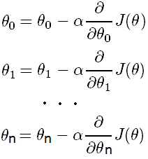
How to reduce the mistake?
Update each slope parameter until Mistake Function
minimum is reached:
Alpha
Learning rate
Derivative
Direction of moving
Simultaneously
Notes:
So, the process of moving towards the minimum until we reach it is basically the simultaneous update of all our random guess theta parameters
When we update each theta parameter we are updating it to move the direction of the minimum with the step defined by the learning rate.
Here the learning rate is alpha, and the direction is defined from the partial derivative of the mistake function for the given theta parameter.
And we are doing this iteratively until we end up at the minimum, where the derivative should be either 0, or very close to 0.

Slide 76
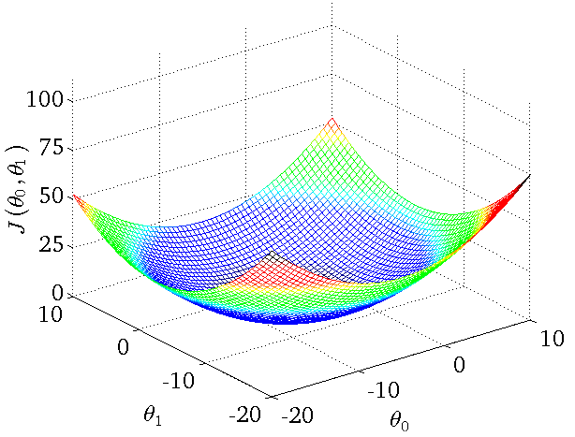
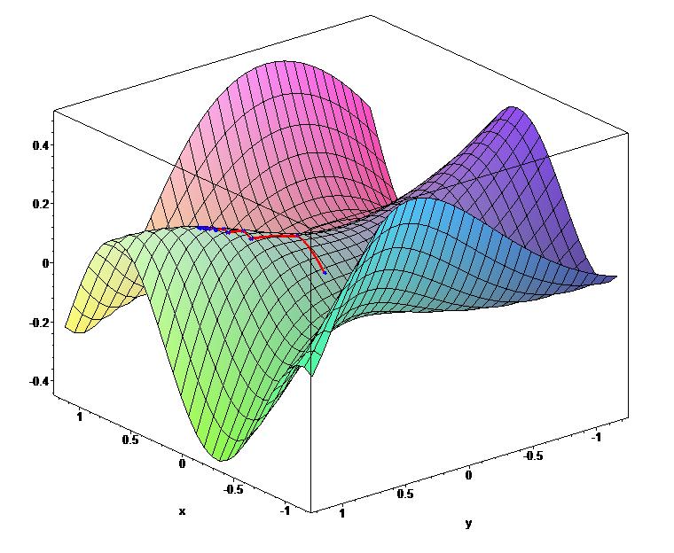
Mistake function looks like…
Global minimums
Notes:
To imagine the cost or mistake function… it can look like this..
When our initial guess theta parameters are wrong, we would be located at the random point on the shape.
When we are minimizing the mistake function, we should literally find the way from the point we are to the minimum of the function.
But how do we know where the minimum is?
First, we can find out the direction, where we should move from our point towards the minimum.
How can we find the direction? If we find the derivative of the mistake function at the point we are – it can be either positive or negative
Positive means that the tangent looks that way and minimum is on the left, so we should move left.. If it’s negative, it means minimum is on the right and we should go right
In addition to the direction of moving towards the minimum we should define the learning rate, that is the size of the step we are making.
If the step is too big then we can overjump the minimum. If it’s too small we may learn very very slowly.

Slide 77
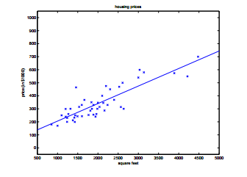
Regression for data shown initially

Slide 78
Regularization
In regression analysis, the features are estimated using coefficients while modelling. Also, if the estimates can be restricted, or shrinked or regularized towards zero, then the impact of insignificant features might be reduced and would prevent models from high variance with a stable fit.
Regularization is the most used technique to penalize complex models in machine learning, it is deployed for reducing overfitting (or, contracting generalization errors) by putting network weights small. Also, it enhances the performance of models for new inputs.
In simple words, it avoids overfitting by panelizing the regression coefficients of high value. More specifically, It decreases the parameters and shrinks (simplifies) the model. This more streamlined model will aptly perform more efficiently while making predictions.
Since, it makes the magnitude to weighted values low in a model, regularization technique is also referred to as weight decay.
Moreover, Regularization appends penalties to more complex models and arranges potential models from slightest overfit to greatest. Regularization assumes that least weights may produce simpler models and hence assist in avoiding overfitting.

Slide 79
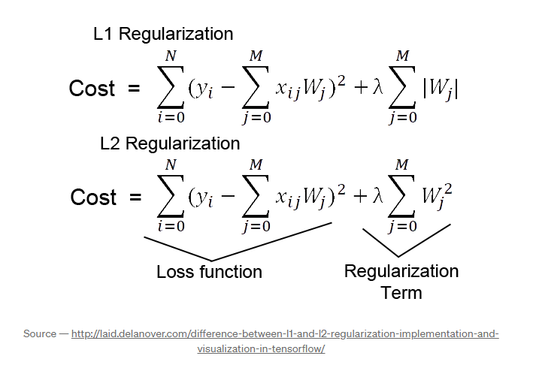
Regularization (L1 Lasso and L2 Ridge)
When you have a large number of features in your data set, you may wish to create a less complex, more parsimonious model. Two widely used regularization techniques used to address overfitting and feature selection are L1 and L2 regularization.
As we can see from the formula of L1 and L2 regularization, L1 regularization adds the penalty term in cost function by adding the absolute value of weight(Wj) parameters, while L2 regularization adds the squared value of weights(Wj) in the cost function.
L1 Regularization, also called a lasso regression, adds the “absolute value of magnitude” of the coefficient as a penalty term to the loss function.
L2 Regularization, also called a ridge regression, adds the “squared magnitude” of the coefficient as the penalty term to the loss function.
A regression model that uses the L1 regularization technique is called lasso regression and a model that uses the L2 is called ridge regression.

Slide 80
Regularization (L1 Lasso and L2 Ridge)
L1 regularization:
Lasso is an acronym for least absolute shrinkage and selection operator, and lasso regression adds the “absolute value of magnitude” of the coefficient as a penalty term to the loss function.
Again, if lambda is zero, then we'll get back OLS (ordinary least squares) whereas a very large value will make coefficients zero, which means it will become underfit.
L1 regularization is excellent when we want a sparse model – where only a subset of the features influence the output. This is particularly useful when dealing with high-dimensional data, where feature selection becomes crucial.
L2 regularization:
Ridge regression adds the “squared magnitude” of the coefficient as the penalty term to the loss function
Here, if lambda is zero then you can imagine we get back OLS. However, if lambda is very large then it will add too much weight and lead to underfitting. Having said that, how we choose lambda is important. This technique works very well to avoid overfitting issues.
L2 regularization is beneficial when all input features contribute to the output. It helps combat the multicollinearity problem by distributing coefficients among correlated features.
The key difference between these techniques is that lasso shrinks the less important feature’s coefficient to zero thus, removing some features altogether. In other words, L1 regularization works well for feature selection in case we have a huge number of features. Where as L2 generally results in small coefficients, distributing importance among features rather than eliminating them.
Elastic Net: When L1 and L2 regularization combine together, it becomes the elastic net method, it adds a hyperparameter.

Slide 81
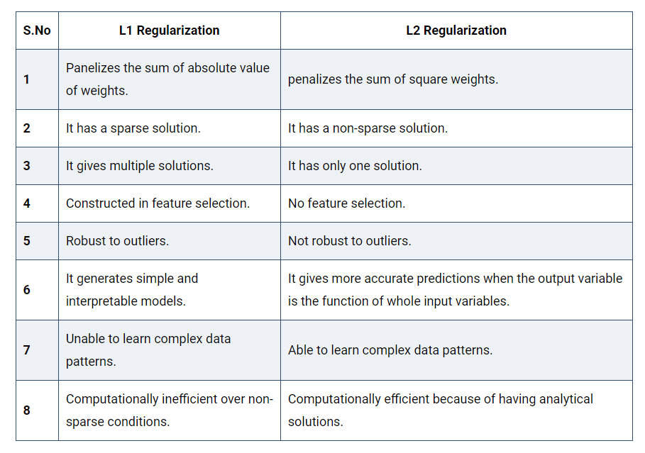
Regularization (L1 Lasso and L2 Ridge)
L1 Pros & Cons:
The pros of L1 regularization include feature selection and improved model interpretability. However, it can produce unstable solutions in the presence of highly correlated features, arbitrarily choosing one and disregarding the others.
L2 Pros & Cons:
The key advantage of L2 regularization is it prevents overfitting without eliminating input features. However, it doesn’t result in sparse models, making it less effective for feature selection.

Slide 82
Regularization
Benefits of Regularization
Regularization improves model generalization by reducing overfitting. Regularized models learn underlying patterns, while overfit models memorize noise in training data.
Regularization techniques such as L1 (Lasso) L1 regularization simplifies models and improves interpretability by reducing coefficients of less important features to zero.
Regularization improves model performance by preventing excessive weighting of outliers or irrelevant features.
Regularization makes models stable across different subsets of the data. It reduces the sensitivity of model outputs to minor changes in the training set.
Regularization prevents models from becoming overly complex, which is especially important when dealing with limited data or noisy environments.
Regularization can help handle multicollinearity (high correlation between features) by reducing the magnitudes of correlated coefficients.
Regularization introduces hyperparameters (e.g., alpha or lambda) that control the strength of regularization. This allows fine-tuning models to achieve the right balance between bias and variance.
Regularization promotes consistent model performance across different datasets. It reduces the risk of dramatic performance changes when encountering new data.
Role Of Regularization
In Python, Regularization is a technique used to prevent overfitting by adding a penalty term to the loss function, discouraging the model from assigning too much importance to individual features or coefficients.
Let’s explore some more detailed explanations about the role of Regularization in Python:
Complexity Control: Regularization helps control model complexity by preventing overfitting to training data, resulting in better generalization to new data.
Preventing Overfitting: One way to prevent overfitting is to use regularization, which penalizes large coefficients and constrains their magnitudes, thereby preventing a model from becoming overly complex and memorizing the training data instead of learning its underlying patterns.
Balancing Bias and Variance: Regularization can help balance the trade-off between model bias (underfitting) and model variance (overfitting) in machine learning, which leads to improved performance.
Feature Selection: Some regularization methods, such as L1 regularization (Lasso), promote sparse solutions that drive some feature coefficients to zero. This automatically selects important features while excluding less important ones.
Handling Multicollinearity: When features are highly correlated (multicollinearity), regularization can stabilize the model by reducing coefficient sensitivity to small data changes.
Generalization: Regularized models learn underlying patterns of data for better generalization to new data, instead of memorizing specific examples.

Slide 83
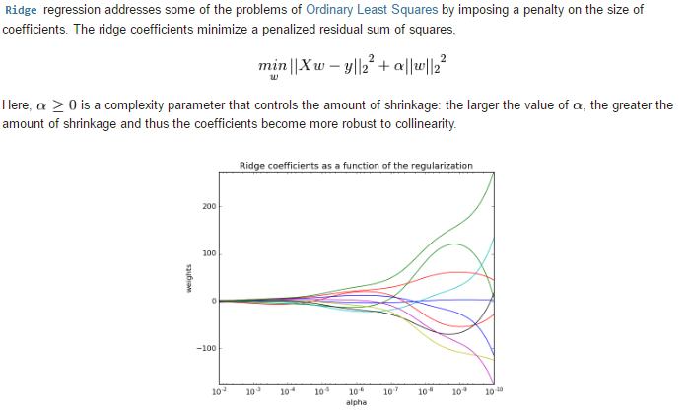
Ridge Regression

Slide 84
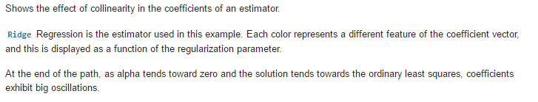
Ridge Regression

Slide 85
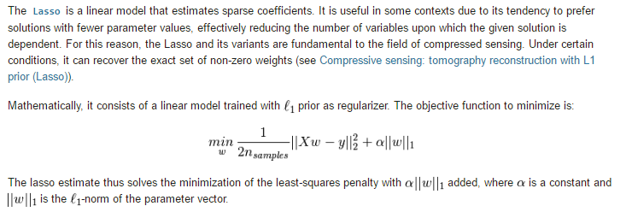
LASSO Regression

Slide 86
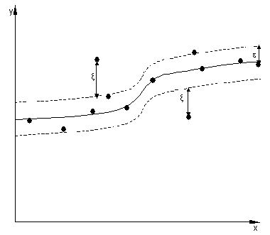

Support Vector Regression
Support Vector Machine can be applied not only to classification problems but also to the case of regression.
Still it contains all the main features that characterize maximum margin algorithm: a non-linear function is learned
by linear learning machine mapping into high dimensional kernel induced feature space. The capacity of the system
is controlled by parameters that do not depend on the dimensionality of feature space.
In the same way as with classification approach there is motivation to seek and optimize the generalization bounds
given for regression. They relied on defining the loss function that ignores errors, which are situated within the certain
distance of the true value. This type of function is often called – epsilon intensive – loss function.
The figure below shows an example of one-dimensional linear regression function with – epsilon intensive – band.
The variables measure the cost of the errors on the training points. These are zero for all points that are inside the band.
The kernel functions transform the data into a higher dimensional feature space to make it possible to perform the linear separation.

Slide 87

Support Vector Regression Kernel Trick
SVR can be used to model both linear and non-linear regression using the different kernels.

Slide 88

Support Vector Regression

Slide 89
Locally Weighted Linear Regression

Slide 90

Locally Weighted Linear Regression

Slide 91

Locally Weighted Linear Regression

Slide 92

Locally Weighted Linear Regression

Slide 93

Locally Weighted Linear Regression

Slide 94

Locally Weighted Linear Regression

Slide 95

Locally Weighted Linear Regression

Slide 96

Locally Weighted Linear Regression

Slide 97

Locally Weighted Linear Regression

Slide 98
Locally Weighted Linear Regression
Applications
The major benefit of locally weighted regression is that fitting a non-linear dataset doesn’t require fiddling manually with features.
Locally weighted linear regression is useful when you have a relatively low dimensional dataset, i.e., when the number of features n𝑛 isn’t too large, say 2 or 3.
Note that there are also constraints on the amount of data that locally weighted linear regression can handle from a computational complexity perspective. The computation needed to fit the minimization is similar to the normal equations, and so it involves solving a linear system of equations of dimension equal to the number of training examples you have.
If you have a few thousands of examples, the computation involved is usually tractable.
If you have tens of millions of examples, then we have to resort to scaling algorithms like KD trees.
However, as we will see from our discussion in the upcoming section on parametric vs. non-parametric learning, the space complexity involved with locally weighted linear regression scales linearly with the number of training examples.

Slide 99
Locally Weighted Linear Regression
Parametric vs. Non-parametric Learning
Linear Regression
With a parametric learning algorithm, you fit a fixed set of parameters θ𝜃 to your data.
The (unweighted) linear regression is a parametric learning algorithm.
No matter how big your training set is, once you train your model and fit the parameters, you could erase the entire training set from memory and make predictions just using the parameters θ𝜃. Your parameters thus represent a summary of your original dataset.
Locally Weighted Linear Regression
Locally weighted regression is a non-parametric learning algorithm. The amount of data you need to keep around to represent the hypothesis h(⋅)ℎ(⋅), grows with the size of the training set. In case of locally weighted regression, this growth rate is linear.
Non-parametric algorithms are not ideal if you have a massive dataset because you need to keep all of the data around in computer memory or on disk just to make predictions.

Slide 100
Bayesian Regression
Linear regression is a popular regression approach in machine learning. Linear regression is based on the assumption that the underlying data is normally distributed and that all relevant predictor variables have a linear relationship with the outcome. But In the real world, this is not always possible, it will follows these assumptions, Bayesian regression could be the better choice.
Bayesian regression employs prior belief or knowledge about the data to “learn” more about it and create more accurate predictions. It also takes into account the data’s uncertainty and leverages prior knowledge to provide more precise estimates of the data. As a result, it is an ideal choice when the data is complex or ambiguous.
Bayesian regression uses a Bayes algorithm to estimate the parameters of a linear regression model from data, including prior knowledge about the parameters. Because of its probabilistic character, it can produce more accurate estimates for regression parameters than ordinary least squares (OLS) linear regression, provide a measure of uncertainty in the estimation, and make stronger conclusions than OLS. Bayesian regression can also be utilized for related regression analysis tasks like model selection and outlier detection.

Slide 101
Bayesian Regression
Bayesian regression is a type of linear regression that uses Bayesian statistics to estimate the unknown parameters of a model. It uses Bayes’ theorem to estimate the likelihood of a set of parameters given observed data. The goal of Bayesian regression is to find the best estimate of the parameters of a linear model that describes the relationship between the independent and the dependent variables.
The main difference between traditional linear regression and Bayesian regression is the underlying assumption regarding the data-generating process. Traditional linear regression assumes that data follows a Gaussian or normal distribution, while Bayesian regression has stronger assumptions about the nature of the data and puts a prior probability distribution on the parameters. Bayesian regression also enables more flexibility as it allows for additional parameters or prior distributions, and can be used to construct an arbitrarily complex model that explicitly expresses prior beliefs about the data. Additionally, Bayesian regression provides more accurate predictive measures from fewer data points and is able to construct estimates for uncertainty around the estimates. On the other hand, traditional linear regressions are easier to implement and generally faster with simpler models and can provide good results when the assumptions about the data are valid.
Bayesian Regression can be very useful when we have insufficient data in the dataset or the data is poorly distributed. The output of a Bayesian Regression model is obtained from a probability distribution, as compared to regular regression techniques where the output is just obtained from a single value of each attribute.

Slide 102
Bayesian Regression
Bayes Theorem gives the relationship between an event’s prior probability and its posterior probability after evidence is taken into account. It states that the conditional probability of an event is equal to the probability of the event given certain conditions multiplied by the prior probability of the event, divided by the probability of the conditions. P(A | B) = (P(B | A) *P(A)) / (P(B)})
Where P(A|B) is the probability of event A occurring given that event B has already occurred, P(B|A) is the probability of event B occurring given that event A has already occurred, P(A) is the probability of event A occurring and P(B) is the probability of event B occurring.

Slide 103
Bayesian Regression
Maximum Likelihood Estimation (MLE)
MLE is a method used to estimate the parameters of a statistical model by maximizing the likelihood function. it seeks to find the parameter values that make the observed data most probable under the assumed model. MLE does not incorporate any prior information or assumptions about the parameters, and it provides point estimates of the parameters
Maximum A Posteriori (MAP) Estimation
MAP estimation is a Bayesian approach that combines prior information with the likelihood function to estimate the parameters. It involves finding the parameter values that maximize the posterior distribution, which is obtained by applying Bayes’ theorem. In MAP estimation, a prior distribution is specified for the parameters, representing prior beliefs or knowledge about their values. The likelihood function is then multiplied by the prior distribution to obtain the joint distribution, and the parameter values that maximize this joint distribution are selected as the MAP estimates. MAP estimation provides point estimates of the parameters, similar to MLE, but incorporates prior information.

Slide 104
Bayesian Regression
Need for Bayesian Regression There are several reasons why Bayesian regression is useful over other regression techniques. Some of them are as follows:
Bayesian regression also uses the prior belief about the parameters in the analysis. which makes it useful when there is limited data available and the prior knowledge are relevant. By combining prior knowledge with the observed data, Bayesian regression provides more informed and potentially more accurate estimates of the regression parameters.
Bayesian regression provides a natural way to measure the uncertainty in the estimation of regression parameters by generating the posterior distribution, which captures the uncertainty in the parameter values, as opposed to the single point estimate that is produced by standard regression techniques. This distribution offers a range of acceptable values for the parameters and can be used to compute trustworthy intervals or Bayesian confidence intervals.
In order to incorporate complicated correlations and non-linearities, Bayesian regression provides flexibility by offering a framework for integrating various prior distributions, which makes it capable to handle situations where the basic assumptions of standard regression techniques, like linearity or homoscedasticity, may not be true. It enables the modeling of more realistic and nuanced relationships between the predictors and the response variable.
Bayesian regression facilitates model selection and comparison by calculating the posterior probabilities of different models.
Bayesian regression can handle outliers and influential observations more effectively compared to classical regression methods. It provides a more robust approach to regression analysis, as extreme or influential observations have a lesser impact on the estimation.

Slide 105
Bayesian Regression Pros and Cons
Advantages of Bayesian Regression:
Very effective when the size of the dataset is small.
Particularly well-suited for on-line based learning (data is received in real-time), as compared to batch-based learning, where we have the entire dataset on our hands before we start training the model. This is because Bayesian Regression doesn’t need to store data.
The Bayesian approach is a tried and tested approach and is very robust, mathematically. So, one can use this without having any extra prior knowledge about the dataset.
Bayesian regression methods employ skewed distributions that let you include outside information in your model.
Disadvantages of Bayesian Regression:
The inference of the model can be time-consuming.
If there is a large amount of data available for our dataset, the Bayesian approach is not worth it and the regular frequentist approach does a more efficient job
If your code is in a setting where installing new packages is challenging and there are strong dependency controls, this might be an issue.
Many of the basic mistakes that commonly plague traditional frequentist regression models still apply to Bayesian models. For instance, Bayesian models still depend on the linearity of the relationship between the characteristics and the outcome variable.
When to use Bayesian Regression:
Small sample size: When you have a tiny sample size, Bayesian inference is frequently quite helpful. Bayesian regression is a wonderful choice if you need to develop a very complicated model but do not have access to a lot of data. In fact, it’s probably the greatest choice you have! Large sample sizes are necessary for many other machine-learning models to work properly.
Strong prior knowledge: The easiest method to include strong external knowledge into your model is by utilising a Bayesian model. The influence of the prior knowledge will be more obvious the smaller the dataset size you work with.

Slide 106
Isotonic Regression
Isotonic regression is a regression technique in which the predictor variable is monotonically related to the target variable. This means that as the value of the predictor variable increases, the value of the target variable either increases or decreases in a consistent, non-oscillating manner.
Mathematically, isotonic regression can be formulated as an optimization problem in which the goal is to find a monotonic function that minimizes the sum of the squared errors between the predicted and observed values of the target variable. The optimization problem can be written as follows: minimize∑(y_i - f(x_i))^2 subject to f(x_1) <= f(x_2) <= ... <= f(x_n)
Where xi and yi are are the predictors and target variables for the ith data point, respectively, and f is the monotonic function that is being fit to the data. The constraint ensures that the function is monotonic.
One way to solve this optimization problem is through a dynamic programming approach, which involves iteratively updating the function by adding one predictor-target pair at a time and making sure that the function remains monotonic at each step.

Slide 107
Isotonic Regression
Applications of Isotonic Regression
Calibration of predicted probabilities: Isotonic regression can be used to adjust the predicted probabilities produced by a classifier so that they are more accurately calibrated to the true probabilities.
Ordinal regression: Isotonic regression can be used to model ordinal variables, which are variables that can be ranked in order (e.g., “low,” “medium,” and “high”).
Non-parametric regression: Because isotonic regression does not make any assumptions about the functional form of the relationship between the predictor and target variables, it can be used as a non-parametric regression method.
Imputing missing values: Isotonic regression can be used to impute missing values in a dataset by predicting the missing values based on the surrounding non-missing values.
Outlier detection: Isotonic regression can be used to identify outliers in a dataset by identifying points that are significantly different from the overall trend of the data.

Slide 108
Stepwise Regression
Stepwise regression is a method of fitting a regression model by iteratively adding or removing variables. It is used to build a model that is accurate and parsimonious, meaning that it has the smallest number of variables that can explain the data.
There are two main types of stepwise regression:
Forward Selection – In forward selection, the algorithm starts with an empty model and iteratively adds variables to the model until no further improvement is made.
Backward Elimination – In backward elimination, the algorithm starts with a model that includes all variables and iteratively removes variables until no further improvement is made.
The advantage of stepwise regression is that it can automatically select the most important variables for the model and build a parsimonious model. The disadvantage is that it may not always select the best model, and it can be sensitive to the order in which the variables are added or removed.
Use of Stepwise Regression?
The primary use of stepwise regression is to build a regression model that is accurate and parsimonious. In other words, it is used to find the smallest number of variables that can explain the data.
Stepwise regression is a popular method for model selection because it can automatically select the most important variables for the model and build a parsimonious model. This can save time and effort for the data scientist or analyst, who does not have to manually select the variables for the model.
Stepwise regression can also improve the model’s performance by reducing the number of variables and eliminating any unnecessary or irrelevant variables. This can help to prevent overfitting, which can occur when the model is too complex and does not generalize well to new data.
Overall, the use of stepwise regression is to build accurate and parsimonious regression models that can handle complex, non-linear relationships in the data. It is a popular and effective method for model selection in many different domains.
Overall, stepwise regression is a useful method for model selection, but it should be used carefully and in combination with other regression methods to ensure that the best model is selected.

Slide 109

Least Angle Regression (LARS)
Least Angle Regression (LARS) is an algorithm used in regression for high dimensional data (i.e., data with a large number of attributes). Least Angle Regression is somewhat similar to forward stepwise regression. Since it is used with data that has lots of attributes, at each step, LARS finds the attribute which is most highly correlated to the target value. There may be more than one attribute that has the same correlation. In this scenario, LARS averages the attributes and proceeds in a direction that is at the same angle to the attributes. This is exactly why this algorithm is called Least Angle regression. Basically, LARS makes leaps in the most optimally calculated direction without overfitting the model.
Algorithm:
Normalize all values to have zero mean and unit variance.
Find a variable that is most highly correlated to the residual. Move the regression line in this direction until we reach another variable that has the same or higher correlation.
Note : Residual is the difference between the observed value and the predicted value. Variable, here implies an attribute.
When we have two variables that have the same correlation, move the regression line at an angle that is in between (i.e., least angle between the two variables).
Continue this until all of our data is exhausted or until you think the model is big and ‘general’ enough.
Mathematically, LARS works as follows :
All coefficients, ‘B’ are set to 0.
The predictor, xj is found that is most correlated to y.
Increase the coefficient Bj in the direction that is most correlated with y and stop when you find some other predictor xk the has equal or higher correlation than xj.
Extend (Bj, Bk) in a direction that is equiangular (has the same angle) to both xj and xk.
Continue and repeat until all predictors are in the model.

Slide 110

A Note on Stochastic GD
Global Minimum
For very large problems it is more efficient to
compute the gradient using a small (random)
subset of the data.
For every new update you pick a new random subset.
Towards convergence, we decrease the step size, This is done by lowering learning rate. This is to take small steps once we are closer to global minima. If we take large steps we might miss minima and model may not converge
Why is this more efficient?
The gradient is an average over many data-points.
If your parameters are very “bad”, every data-point will
tell you to move in the same direction, so you need only a
few data-points to find that direction.
Towards convergence you need all the data-points.
A small step-size effectively averages over many data-points.

Slide 111
Gradient Descent or Stochastic Gradient Descent
Gradient descent can be used to minimize any function, but here we will use it to minimize our cost function for linear regression.
Let’s outline on a high level, how this algorithm works:
Start with some parameters theta
Computes gradient using a single Training example.
Keep changing the values for theta to reduce the cost function J(theta)
Continue until we settle at or near a minimum. Note, some functions may have more than 1 minimum

Slide 112
Gradient Descent or Stochastic Gradient Descent
Note the learning rate alpha, it determines how big of a step you take when updating theta
If the learning rate is too small, you end up taking too many steps to hit the local minimum which is inefficient. Gradient descent will work but it will be too slow. If the learning rate is too large, you may take a step that is too big as miss the minimum. Gradient descent will fail to converge. How should we choose the learning rate then? A few good values to start off with are 0.001,0.01,0.1,1 and so on.
For each value, you might just run gradient descent for a handful of iterations and plot the cost function J as a function of the number of iterations.
How do we know we are close to the local minimum? Via a game of hot and cold because as we get near a local minimum, the derivative becomes smaller. Update steps towards the local minimum become smaller, thus, we can reach the minimum without decreasing the learning rate.
How can we check gradient descent is working correctly? We can have 2 ways to achieve this. We can plot the cost function J, which is calculated on the training set, and plot the value of J at each iteration (aka each simultaneous update of parameters theta) of gradient descent. We can also use an Automatic convergence test. We choose an ϵ to be a very small number. If the cost J decreases by less than ϵ on one iteration, then you’re likely on this flattened part of the curve, and you can declare convergence.

Slide 113
Gradient Descent and it’s drawbacks
As we know Gradient descent is an optimization algorithm used to minimize some function by iteratively moving in the direction of steepest descent, defined by the negative of the function’s gradient. In the context of machine learning, the function we’re typically interested in minimizing is the cost or loss function.
In gradient descent, the update equation is given by:
theta = theta - learning_rate * gradient_of_cost_function
where:
theta represents the parameters of our model
learning_rate is a hyperparameter that determines the step size during each iteration while moving toward a minimum of a loss function
gradient_of_cost_function is the gradient of our loss function
The Problem with Vanilla Gradient Descent
In high-dimensional input spaces, cost functions can have many elongated valleys, leading to a zigzagging pattern of optimization if using vanilla gradient descent. This is because the direction of the steepest descent usually doesn’t point towards the minimum but instead perpendicular to the direction of the valley. As a result, gradient descent can be very slow to traverse the bottom of these valleys.

Slide 114
Gradient Descent with Momentum
Optimization algorithms play a pivotal role in training machine learning models. Among various optimization techniques, gradient descent has gained immense popularity for its simplicity and effectiveness. However, vanilla gradient descent has its drawbacks, such as slow convergence and vulnerability to oscillations and local minima. To overcome these issues, an enhanced version of gradient descent called “Gradient Descent with Momentum” was introduced
Gradient Descent with Momentum is a technique that helps accelerate gradients vectors in the right directions, thus leading to faster converging. It is one of the most popular optimization algorithms and an effective variant of the standard gradient descent algorithm.
The idea of momentum is derived from physics. A ball rolling down a hill gains momentum as it goes, becoming faster and faster on the way (unless friction or air resistance is considered). In the context of optimization algorithms, the ‘ball’ is the set of parameters we’re trying to optimize.

Slide 115
Gradient Descent with Momentum
To incorporate momentum, we introduce a variable v (velocity), which serves as a moving average of the gradients. In the case of deep learning, this is often referred to as the “momentum term”. The update equations are:
v = beta * v - learning_rate * gradient_of_cost_function
theta = theta + v
where:
beta is a new hyperparameter introduced which determines the level of momentum (usually set to values like 0.9)
v is the moving average of our gradients

Slide 116

Gradient Descent with Momentum:
Basic Idea: This method introduces a velocity component that accumulates the gradient of the past steps to determine the next step. It’s akin to a ball rolling downhill, gaining momentum (and speed) according to the steepness of the slope.
Advantages: The momentum term smoothens the optimization trajectory and can help overcome shallow local minima or small plateaus in the loss landscape. The accumulated past gradients give it a sort of “memory” of where it’s been.
Disadvantages: Introduces an additional hyperparameter (momentum factor, usually denoted as ( \gamma )).
Algorithms with momentum have a smoother trajectory than non-momentum based but this may result in overshooting.
Algorithms that do not scale the step size (adaptive learning rate) have a harder time to escape local minimums and break the symmetry of the loss function
Methods with an adaptive learning rate have a faster convergence rate, better stability, and less jittering.
https://theaisummer.com/optimization/

Slide 117


Gradient Descent with Momentum:

Slide 118
Advantages of Gradient Descent with Momentum
Faster Convergence: By adding a momentum term, our optimizer takes into account the past gradients to smooth out the update. We get a faster convergence and reduced oscillation.
Avoiding Local Minima: The momentum term increases the size of the steps taken towards the minimum and helps escape shallow (i.e., non-optimal) local minima.
Reducing Oscillations: It dampens oscillations and speeds up the process along the relevant direction, leading to quicker convergence.
Gradient Descent with Momentum is a simple yet powerful optimization technique that has been proven to be effective for training deep learning models. It combines the strengths of gradient descent while overcoming its weaknesses by incorporating a momentum term, ensuring smoother and faster convergence.

Slide 119
Stochastic Gradient Descent (SGD):
Basic Idea: Instead of calculating the gradient based on the entire dataset (as in batch gradient descent), SGD estimates the gradient based on a single example or a mini-batch at each iteration.
Advantages: Faster convergence since it doesn’t have to process the whole dataset at every step. Additionally, the noise in the gradient estimation can help escape shallow local minima.
Disadvantages: The updates can be very noisy, leading to oscillations in the convergence path. This noise can be mitigated using learning rate schedules or mini-batches, but raw SGD can still be less stable than some of its variants.

Slide 120
Adam (Adaptive Moment Estimation):
Basic Idea: Adam can be thought of as a combination of SGD with momentum and RMSProp (another optimization algorithm). It maintains moving averages of both the gradients (momentum) and the squared gradients.
Advantages: Adam adjusts the learning rate of each parameter adaptively, based on the first and second moments of the gradients. This often results in faster convergence and is less sensitive to the initial learning rate.
Disadvantages: Introduces more hyperparameters than basic SGD, although in practice the default values often work well (e.g., ( \beta_1 = 0.9, \beta_2 = 0.999 )). There have been some discussions in the research community about potential issues with Adam, like poor generalization performance or convergence problems in certain scenarios, but it remains a popular choice for many tasks.

Slide 121
Summary
SGD provides a baseline optimization method, is simple, and can be effective with a well-tuned learning rate and mini-batches.
Momentum accelerates convergence by taking into account past gradients, especially in scenarios with noisy or sparse gradients.
Adam is an adaptive method that often requires less tuning of the learning rate and can converge faster in many scenarios, but it comes with more hyperparameters.

Slide 122
Use Cases
Stochastic Gradient Descent (SGD)
SGD estimates the gradient based on a small subset of data, like one example or mini-batch. It is simple, easy to implement, and computationally efficient.
Use cases:
When you have large datasets that don’t fit into memory. SGD allows online updating.
For models with high capacity that can overfit batch methods. The noise in SGD acts as regularization.
As a baseline optimization method. Tuning the learning rate schedule is important.

Slide 123
Use Cases
Momentum accelerates SGD by accumulating gradients from previous steps to determine the direction of the update. It helps overcome plateaus and local minima.
Use cases:
When vanilla SGD is too noisy or unstable. The momentum term smooths the path.
In cases where the loss surface has many ravines, curvature, and local optima. The momentum can help escape.
When training deep neural networks, momentum is almost always helpful.

Slide 124
Use Cases
Adam adaptively estimates first and second moments of the gradients (akin to momentum and RMSProp). It adjusts the learning rate for each parameter.
Use cases:
When you want a method that is adaptive and requires little tuning of hyperparameters. Adam generally works well with defaults.
For training deep neural networks, Adam often outperforms vanilla SGD and even Momentum, hence its popularity.
In some cases, alternate methods like LAMB and RAdam have been proposed to improve on Adam.

Slide 125
Batch SGD Vs Minibatch SGD Vs SGD
Stochastic Gradient Descent (SGD):
In traditional SGD, the model parameters are updated after processing each individual training example.
It randomly selects one training example at a time and computes the gradient of the loss function with respect to the parameters based on that single example.
The model parameters are then updated using this gradient estimate, and the process is repeated for the next randomly selected example.
SGD has the advantage of being computationally efficient, as it only requires processing one example at a time.
However, the updates can be noisy and may result in slower convergence since the gradient estimate is based on a single example.

Slide 126
Batch SGD Vs Minibatch SGD Vs SGD
Batch Stochastic Gradient Descent (Batch SGD):
Batch SGD is a variation of SGD where instead of processing one example at a time, it processes a large or entire batch of training examples simultaneously.
The model computes the gradient of the loss function based on this batch of examples and updates the parameters accordingly.
The batch size is typically chosen to be larger than one but smaller than the total number of training examples.
Batch SGD provides a balance between the computational efficiency of SGD and the stability of traditional Batch Gradient Descent.
It reduces the noise in the gradient estimates compared to SGD and can result in faster convergence.
Batch SGD is commonly used in practice as it combines the benefits of efficient parallelization and more stable updates.

Slide 127
Batch SGD Vs Minibatch SGD Vs SGD
Minibatch SGD:
In minibatch SGD, instead of processing one training example (SGD) or a full batch of examples (Batch SGD) at a time, a small subset of training examples, called a minibatch, is processed.
The minibatch size is typically larger than one but smaller than the total number of training examples. It is chosen based on the computational resources and the desired trade-off between computational efficiency and stability of updates.
The model computes the gradient of the loss function based on the minibatch examples and updates the parameters accordingly.
This process is repeated iteratively, with different minibatches sampled from the training data, until all examples have been processed (one pass over the entire dataset is called an epoch).
Minibatch SGD provides a balance between the noisy updates of SGD and the stability of Batch SGD.
It reduces the noise in the gradient estimates compared to SGD and allows for better utilization of parallel computation resources compared to Batch SGD.
Minibatch SGD is widely used in practice as it offers a good compromise between computational efficiency and convergence stability.

Slide 128
Batch SGD Vs Minibatch SGD Vs SGD Pros and Cons
Batch Gradient Descent:
In Batch Gradient descent the whole training data is used to minimize the loss function by taking a step towards the nearest minimum by calculating the gradient (the direction of descent).
Pros:
Since the whole data set is used to calculate the gradient it will be stable and reach the minimum of the cost function without bouncing around the loss function landscape (if the learning rate is chosen correctly).
Cons:
Since batch gradient descent uses all the training set to compute the gradient at every step, it will be very slow especially if the size of the training data is large.

Slide 129
Batch SGD Vs Minibatch SGD Vs SGD Pros and Cons
Stochastic Gradient Descent:
Stochastic Gradient Descent picks up a random instance in the training data set at every step and computes the gradient-based only on that single instance.
Pros:
It makes the training much faster as it only works on one instance at a time.
It become easier to train using large datasets.
Cons:
Due to the stochastic (random) nature of this algorithm, this algorithm is much less stable than the batch gradient descent. Instead of gently decreasing until it reaches the minimum, the cost function will bounce up and down, decreasing only on average. Over time it will end up very close to the minimum, but once it gets there it will continue to bounce around, not settling down there. So once the algorithm stops, the final parameters would likely be good but not optimal. For this reason, it is important to use a training schedule to overcome this randomness.

Slide 130
Batch SGD Vs Minibatch SGD Vs SGD Pros and Cons
Mini-batch Gradient:
At each step instead of computing the gradients on the whole data set as in the Batch Gradient Descent or using one random instance as in the Stochastic Gradient Descent, this algorithm computes the gradients on small random sets of instances called mini-batches.
Pros:
The algorithm’s progress space is less erratic than with Stochastic Gradient Descent, especially with large mini-batches.
You can get a performance boost from hardware optimization of matrix operations, especially when using GPUs.
Cons:
It might be difficult to escape from local minima.

Slide 131
Loss Functions
https://www.datacamp.com/tutorial/loss-function-in-machine-learning

Slide 132
Loss Functions in Brief
The key takeaway is that the loss function is a measurable way to gauge the performance and accuracy of a machine learning model. In this case, the loss function acts as a guide for the learning process within a model or machine learning algorithm.
The role of the loss function is crucial in the training of machine learning models and includes the following:
Performance measurement: Loss functions offer a clear metric to evaluate a model's performance by quantifying the difference between predictions and actual results.
Direction for improvement: Loss functions guide model improvement by directing the algorithm to adjust parameters(weights) iteratively to reduce loss and improve predictions.
Balancing bias and variance: Effective loss functions help balance model bias (oversimplification) and variance (overfitting), essential for the model's generalization to new data.
Influencing model behavior: Certain loss functions can affect the model's behavior, such as being more robust against data outliers or prioritizing specific types of errors.

Slide 133
What is a Loss Function?
The loss function, also referred to as the error function, is a crucial component in machine learning that quantifies the difference between the predicted outputs of a machine learning algorithm and the actual target values. For example, within a regression problem to predict car prices based on historical data, a loss function evaluates a neural network prediction based on a training sample from the training dataset. The loss function quantifies the gap or the error margin of the car price predicted by the network to the actual price.
The resulting value, the loss, reflects the accuracy of the model's predictions. During training, a learning algorithm such as the backpropagation algorithm uses the gradient of the loss function with respect to the model's parameters to adjust these parameters and minimize the loss, effectively improving the model's performance on the dataset.
Often, the terms loss function and cost function are used interchangeably; despite this, both terms have distinct definitions:
As mentioned earlier, the loss function, also known as the error function, quantifies how well a single prediction of the machine learning algorithm is compared to the actual target value. The key takeaway is that a loss function applies to a single training example and is part of the overall model's learning process that provides the signal by which the model's learning algorithm updates the weights and parameters.
The cost function, sometimes called the objective function, is an average of the loss function of an entire training set containing several training examples. The cost function quantifies the model's performance on the whole training dataset.

Slide 134
How Loss Functions Work
Although there are different types of loss functions, fundamentally, they all operate by quantifying the difference between a mode’s predictions and the actual target value in the dataset. The official term for this numerical quantification is the prediction error. The learning algorithm and mechanisms in a machine learning model are optimized to minimize the prediction error, so this means that after a calculation of the value for the loss function, which is determined by the prediction error, the learning algorithm leverages this information to conduct weight and parameter updates which in effect during the next training pass leads to a lower prediction error.
When exploring the topic of loss function, machine learning algorithms, and the learning process within neural networks, the topic of Empirical Risk Minimization(ERM) comes up. ERM is an approach to selecting the optimal parameters of a machine learning algorithm that minimizes the empirical risk. The empirical risk, in this case, is the training dataset.
The risk minimization component of ERM is the process by which the internal learning algorithm minimizes the error of prediction of machine learning algorithm to a known dataset in the outcome that the model has an expected performance and accuracy in a scenario where an unseen dataset or data sample which could have similar statical data distribution as the dataset the model’s has been initially trained on.

Slide 135

Types of Loss Functions
Loss functions in machine learning can be categorized based on the machine learning tasks to which they are applicable. Most loss functions apply to regression and classification machine learning problems. The model is expected to predict continuous output values for regression machine learning tasks. In contrast, the model is expected to provide discrete labels corresponding to a dataset class for classification tasks.
Below are standard loss functions and their classification into machine learning problems they lend themselves well to.

Slide 136
Loss Functions for Regression
Mean Square Error (MSE) / L2 Loss
The Mean Square Error(MSE) or L2 loss is a loss function that quantifies the magnitude of the error between a machine learning algorithm prediction and an actual output by taking the average of the squared difference between the predictions and the target values. Squaring the difference between the predictions and actual target values results in a higher penalty assigned to more significant deviations from the target value. A mean of the errors normalizes the total errors against the number of samples in a dataset or observation.
The mathematical equation for Mean Square Error (MSE) or L2 Loss is:
MSE = (1/n) * Σ(yᵢ - ȳ)²
Where:
n is the number of samples in the dataset
yᵢ is the predicted value for the i-th sample
ȳ is the target value for the i-th sample

Slide 137
Loss Functions for Regression
Mean Square Error (MSE) / L2 Loss
When to use MSE
Understanding when to use MSE is crucial in machine learning model development. MSE is a standard loss function utilized in most regression tasks since it directs the model to optimize to minimize the squared differences between the predicted and target values.
MSE is recommended for ML scenarios where it is conducive to the learning process to penalize significantly the presence of outliers. However, these characteristics of MSE are not always suitable for scenarios and use cases where outliers are due to noise from the data as opposed to positive signals.
An example scenario of when the MSE loss function is leveraged is in real estate price prediction or, more broadly, predictive modelling. Predicting house prices involves using features such as the number of rooms, location, area, distance from amenities and other numerical features. House prices in a localized area are normally distributed, so the objective to penalize outliers is essential to the model’s ability to predict accurate house prices.
A small percentage error in real estate can equate to a significant amount of money. For instance, a 5% error in a $200,000 house is $10,000, which is substantial. Hence, squaring the errors (as done in MSE) helps in giving higher weight to larger errors, thus pushing the model to be more precise with higher-valued properties.

Slide 138
Loss Functions for Regression
Mean Absolute Error (MAE) / L1 Loss
Mean Absolute Error (MAE), also known as L1 Loss, is a loss function used in regression tasks that calculates the average absolute differences between predicted values from a machine learning model and the actual target values. Unlike Mean Squared Error (MSE), MAE does not square the differences, treating all errors with equal weight regardless of their magnitude.
The mathematical equation for Mean Absolute Error (MAE) or L1 Loss is:
MAE = (1/n) * Σ|yᵢ - ȳ|
Where:
n is the number of samples in the dataset
yᵢ is the predicted value for the i-th sample
ȳ is the target value for the i-th sample

Slide 139
Loss Functions for Regression
Mean Absolute Error (MAE) / L1 Loss
When to use MAE
MAE measures the average absolute difference between the predicted and actual values. Unlike MSE, MAE does not square the differences, which makes it less sensitive to outliers. Compared to Mean Squared Error (MSE), Mean Absolute Error (MAE) is inherently less sensitive to outliers because it assigns an equal weight to all errors, regardless of their magnitude.
This means that while an outlier can significantly skew the MSE by contributing a disproportionately large error when squared, its impact on MAE is much more contained. An outlier's influence on the overall error metric is minimal when using MAE as a loss function. In contrast, MSE amplifies the effect of outliers due to the squaring of error terms, affecting the model's error estimation more substantially.
A scenario where MAE is an applicable loss function is one where we don't want to penalize outliers considerably or at all, for example, predicting delivery times for a food delivery company.
A delivery services company such as UberEats, Deliveroo, or DoorDash might build a delivery estimation model to increase customer satisfaction. The time taken for a delivery service to get food delivered is affected by several factors such as weather, traffic incidents, roadworks, etc.
Handling these factors is crucial to the estimation of delivery times. One method of handling this is to classify these events as outliers but make the decision to ensure it doesn't affect the model being trained. MAE is a suitable loss function within this scenario as it will treat data points that are outliers due to roadworks or rare events with less severity, reducing the effect of the outliers on the error metric and model's learning process.
MAE notably adds a uniform error weighting to all data points; in the scenario described, penalizing outlier data points could result in over-estimating or under-estimating delivery times.

Slide 140
Loss Functions for Regression
Huber Loss / Smooth Mean Absolute Error
Huber Loss or Smooth Mean Absolute Error is a loss function that takes the advantageous characteristics of the Mean Absolute Error and Mean Squared Error loss functions and combines them into a single loss function. The hybrid nature of Huber Loss makes it less sensitive to outliers, just like MAE, but also penalizes minor errors within the data sample, similar to MSE. The Huber Loss function is also utilized in regression machine learning tasks.
The mathematical equation for Huber Loss is as follows:
L(δ, y, f(x)) = (1/2) * (f(x) - y)^2 if |f(x) - y| <= δ
= δ * |f(x) - y| - (1/2) * δ^2 if |f(x) - y| > δ
Where:
L represents the Huber Loss function
δ is the delta parameter, which determines the threshold for switching between the quadratic and linear components of the loss function
y is the true value or target value
f(x) is the predicted value

Slide 141
Loss Functions for Classification
Binary Cross-Entropy Loss / Log Loss
Binary Cross-Entropy Loss(BCE) is a performance measure for classification models that outputs a prediction with a probability value typically between 0 and 1, and this prediction value corresponds to the likelihood of a data sample belonging to a class or category. In the case of Binary Cross-Entropy Loss, there are two distinct classes. But notably, a variant of cross-entropy loss, Categorical Cross-Entropy applies to multiclass classification scenarios.
To understand Binary Cross-Entropy Loss, sometimes called Log Loss, it is helpful to discuss the components of the terms.
Loss: This is a mathematical quantification of the margin/difference between the prediction of a machine learning algorithm and the actual target value.
Entropy: A simple definition of entropy is that it is a calculation of the degree of randomness or disorder within a system
Cross Entropy: This is a term commonly utilised in information theory, and it measures the differences between two probability distributions that can be used to identify an observation.
Binary: This is an expression of numerical digits using either of two states, 0 or 1. This is extended to the definition of Binary Classification where we ditingus=ish two classes(A and B) using binary representation, where class A is assigned the numerical representation of 0 and class B is assigned 1.

Slide 142
Loss Functions for Classification
Binary Cross-Entropy Loss / Log Loss
Binary Cross Entropy Loss (or Log Loss) is a quantification of the difference between the prediction of a machine learning algorithm and the actual target prediction that is calculated from the negative value of the summation of the logarithm value of the probabilities of the predictions made by the machine learning algorithm against the total number of data samples. BCE is found in machine learning use cases that are logistic regression problems and in training artificial neural networks designed to predict the likelihood of a data sample belonging to a class and leverage the sigmoid activation function internally.
The mathematical equation for Binary Cross-Entropy Loss, also known as Log Loss, is:
L(y, f(x)) = -[y * log(f(x)) + (1 - y) * log(1 - f(x))]
Where:
L represents the Binary Cross-Entropy Loss function
y is the true binary label (0 or 1)
f(x) is the predicted probability of the positive class (between 0 and 1)

Slide 143
Loss Functions for Classification
Binary Cross-Entropy Loss / Log Loss
When to use Binary Cross-Entropy Loss / Log Loss
The equation above specifically applies to a scenario where the machine learning algorithm will make a classification between two classes. This is a binary classification scenario.
As noted in the equation by the negative symbol: ‘-’ BCE calculates the loss by determining the negative of two terms, and for several predictions or data samples, the average of the negative of the following two terms:
The logarithm of the model’s predicted probability went the positive class is present y * log(f(x))
The logarithm of 1 minus the predicted probability of the negative class: (1 - y) * log(1 - f(x))
The BCE loss function penalizes inaccurate predictions, which are predictions that have a significant difference from the positive class or, in other words, have a high quantification of entropy. When BCE is utilized as a component within learning algorithms, this encourages the model to refine its predictions, which are probabilities for the appropriate class during its training.

Slide 144
Loss Functions for Classification
Hinge Loss
Hinge Loss is a loss function utilized within machine learning to train classifiers that optimize to increase the margin between data points and the decision boundary. Hence, it is mainly used for maximum margin classifications. To ensure the maximum margin between the data points and boundaries, hinge loss penalizes predictions from the machine learning model that are wrongly classified, which are predictions that fall on the wrong side of the margin boundary and also predictions that are correctly classified but are within close proximity to the decision boundary.
This characteristic of the Hinge Loss function ensures machine learning models are able to predict the accurate classification of data points to their target value with confidence that exceeds the threshold of the decision boundary. This approach to machine algorithm learning enhances the model's generalization capabilities, making it effective for accurately classifying data points with a high degree of certainty.
The mathematical equation for Hinge Loss is:
L(y, f(x)) = max(0, 1 - y * f(x))
Where:
L represents the Hinge Loss
y is the true label or target value (-1 or 1)
f(x) is the predicted value or decision function output

Slide 145
Choosing the Right Loss Function
Selecting the appropriate loss function to apply to a machine learning algorithm is essential, as the model's performance heavily depends on the algorithm's ability to learn or adapt its internal weights to fit a dataset.
A machine learning model or algorithm's performance is defined by the loss function utilized, mainly because the loss function component affects the learning algorithm used to minimize the model's error loss or cost function value. Essentially, the loss function impacts the model's ability to learn and adapt the value of its internal weights to fit the patterns within a dataset.
When appropriately selected, the loss function enables the learning algorithm to effectively converge to an optimal loss during its training phase and generalize well to unseen data samples. An appropriately selected loss function acts as a guide, steering the learning algorithm towards accuracy and reliability, ensuring that it captures the underlying patterns in the data while avoiding overfitting or underfitting.

Slide 146
Factors to consider when selecting a loss function
Understanding the type of machine learning problem at hand helps determine a category of loss function to utilize. Different loss functions apply to various machine-learning problems.
Classification vs Regression
Classification machine learning tasks usually involve assigning data points to a specific category label. With this type of machine learning task, the output of the machine learning model is typically a set of probabilities that determine the likelihood of a data point being a certain label.
The cross-entropy loss function is commonly used for classification tasks. In a machine learning regression task where the objective is for a machine learning model to produce a prediction based on a set of inputs, loss functions such as mean squared error or mean absolute error are better suited.
Binary vs Multiclass Classification
Binary classification involves the categorization of data samples into two distinct categories, whereas multiclass classification, as the name suggests, involves the categorization of data samples into more than two categories. For machine learning classification problems that involve just two classes(binary classification), leveraging a binary cross-entropy loss function is best. In situations where more than two classes are targets for predictions, categorical cross-entropy should be utilized.

Slide 147

Factors to consider when selecting a loss function
Sensitivity
Another factor to consider is the sensitivity of the loss function to outliers. In some scenarios, it is desirable to ensure that outliers and data samples that skew the overall statistical distribution of the dataset are penalized during training; in such scenarios, loss functions such as mean squared error are suitable.
Whereas there are scenarios where less sensitivity to outliers is required, these are scenarios where outliers could be 'never events' or unlikely to happen. For this objective, penalizing outliers might produce a non-performant model. Loss function such as mean absolute error is applicable in such scenarios. For the best of both worlds, practitioners should consider the Huber loss function, which takes components that penalize outliers with low error values and reduce the model's sensitivity to outliers with large error values.
Computational efficiency
Computational resource is a commodity within machine learning, commercial, and research domain. Access to large computing capacity enables practitioners the flexibility to experiment with large datasets and solve more complex machine-learning problems. Some loss functions are more computationally demanding than others, especially when the number of datasets is large. This makes the computational efficiency of a loss function a factor to consider during the selection process of a loss function.

Slide 148

Impact of outliers and data distribution
Outliers are data samples that fall outside the overall statistical distribution of a dataset; they are sometimes referred to as anomalies or irregularities. How outliers are managed determines the performance and accuracy of the trained machine learning model.
As mentioned earlier, outliers in datasets affect the error values utilized in loss functions, depending on the loss function used. The effect of outliers on the loss functions propagates to the outcome of the learning process of the machine learning algorithm, which can lead to intended or unintended behavior from the machine learning algorithm or model.
For example, mean squared error penalizes outliers contributing to large error values/terms; this means during the training process, the model weights are adjusted to learn how to accommodate these outliers. Again, if this isn’t the intended behavior of the machine learning model, the finalized model created after training will have poor generalization to unseen data. For scenarios where mitigating the impact of outliers is required, functions such as MAE and Huber loss are more applicable.

Slide 149


Difference between Binary, Multi-class & Multi-label Classification
Binary Classification is where each data sample is assigned one and only one label from two mutually exclusive classes.
Multiclass Classification is where each data sample is assigned one and only one label from more than two classes.
Multi-label Classification is a type of supervised machine learning algorithm that can be used to assign zero or more labels to each data sample.
To summarize, binary classification is a supervised machine learning algorithm that is used to predict one of two classes for an item, while multiclass and multilabel classification is used to predict one or more classes for an item. While a multiclass classifier must assign one and only one class or label to each data sample, a multilabel classifier can assign zero or more classes or labels to the same data sample. Binary classification can be used for a variety of applications such as spam detection and fraud detection, while multiclass and multilabel classification is often used in image recognition and document classification tasks.

Slide 150

Logistic Regression
Output is not a number from some continuous range – output is the category (black or white, yes or no)
Logistic regression is a classification algorithm that may have only two categories on the output, so it’s binary classification
Name is somewhat misleading. Really a technique for classification, not regression. “Regression” comes from fact that we fit a linear model to the feature space.
Notes:
Classification.
Output is not a number from some continuous range – output is the category (black or white, yes or no)
Logistic regression is a classification algorithm that may have only two categories on the output, so it’s binary classification

Slide 151
Logistic Regression
Key Points:
Logistic regression predicts the output of a categorical dependent variable. Therefore, the outcome must be a categorical or discrete value.
It can be either Yes or No, 0 or 1, true or False, etc. but instead of giving the exact value as 0 and 1, it gives the probabilistic values which lie between 0 and 1.
In Logistic regression, instead of fitting a regression line, we fit an “S” shaped logistic function, which predicts two maximum values (0 or 1).
Logistic Function – Sigmoid Function
The sigmoid function is a mathematical function used to map the predicted values to probabilities.
It maps any real value into another value within a range of 0 and 1. The value of the logistic regression must be between 0 and 1, which cannot go beyond this limit, so it forms a curve like the “S” form.
The S-form curve is called the Sigmoid function or the logistic function.
In logistic regression, we use the concept of the threshold value, which defines the probability of either 0 or 1. Such as values above the threshold value tends to 1, and a value below the threshold values tends to 0.
Types of Logistic Regression
On the basis of the categories, Logistic Regression can be classified into three types:
Binomial: In binomial Logistic regression, there can be only two possible types of the dependent variables, such as 0 or 1, Pass or Fail, etc.
Multinomial: In multinomial Logistic regression, there can be 3 or more possible unordered types of the dependent variable, such as “cat”, “dogs”, or “sheep”
Ordinal: In ordinal Logistic regression, there can be 3 or more possible ordered types of dependent variables, such as “low”, “Medium”, or “High”.

Slide 152

Logistic Regression
Assumptions of Logistic Regression
We will explore the assumptions of logistic regression as understanding these assumptions is important to ensure that we are using appropriate application of the model. The assumption include:
Independent observations: Each observation is independent of the other. meaning there is no correlation between any input variables.
Binary dependent variables: It takes the assumption that the dependent variable must be binary or dichotomous, meaning it can take only two values. For more than two categories SoftMax functions are used.
Linearity relationship between independent variables and log odds: The relationship between the independent variables and the log odds of the dependent variable should be linear.
No outliers: There should be no outliers in the dataset.
Large sample size: The sample size is sufficiently large

Slide 153

Different ways of expressing probability
Notes:
Maximum likelyhood

Slide 154

Log odds

Slide 155

From probability to log odds (and back again)

Slide 156

Logistic Regression

Slide 157


Using Logistic Regression Model

Slide 158

Logistic Regression

Slide 159


Hypothesis function
Estimated probability that Y = 1 on input X
Squashing function to map the reals to a finite domain.
Notes:
Here we also have our guess or hypothesis function, that is different here.
In the simplest Linear Regression it was a line, here as the outcome is categorical we have the guess function that outputs the estimated probability that the output would be equal to one for the given set of inputs.
This function is called sigmoid or logistics function.
And here we also have the set of random theta parameters or weights, that are located in the degree of e at the bottom part of the equation.

Slide 160

The logit / sigmoid
Determines the offset
Determines the angle
and the steepness.

Slide 161


Mistake function
Mistake function is the cost for a single training data example
h(x)
Notes:
The mistake function here for each training sample can be divided into two parts.
As out outcome can be either one category or another category, so either 0 or 1 ….
…. Then, if the real outcome for the data sample of predictors is really 1, and our guess function outputs 0 – then the mistake should grow when the guess decreases
… if the real outcome is 0, and our guess is 1, which is wrong.. Then out mistake should increase as our guess value increases.
That is the mistake function for separate data samples

Slide 162


Slide 163


Slide 164
Generalized Linear Models (GLM)
In our discussion of linear regression, we had y∣x;θ∼N(μ,σ2) , while in logistic regression, y∣x;θ∼Bernoulli(ϕ), for some appropriate definitions of μ and ϕ as functions of x and θ
In this topic, we will show that both of these methods are special cases of a broader family of models, called Generalized Linear Models (GLMs). We will also show how other models in the GLM family can be derived and applied to other classification and regression problems.

Slide 165

Generalized Linear Models (GLM)

Slide 166

Generalized Linear Models (GLM)

Slide 167

Generalized Linear Models (GLM)

Slide 168

Generalized Linear Models (GLM)

Slide 169

Generalized Linear Models (GLM)

Slide 170

Generalized Linear Models (GLM)

Slide 171

Generalized Linear Models (GLM)

Slide 172

Generalized Linear Models (GLM)

Slide 173

Generalized Linear Models (GLM)

Slide 174

Generalized Linear Models (GLM)

Slide 175

Generalized Linear Models (GLM)

Slide 176

Generalized Linear Models (GLM)

Slide 177

Generalized Linear Models (GLM)

Slide 178

Generalized Linear Models (GLM)

Slide 179

Generalized Linear Models (GLM)

Slide 180

Generalized Linear Models (GLM)

Slide 181

Generalized Linear Models (GLM)

Slide 182

Generalized Linear Models (GLM)

Slide 183

Generalized Linear Models (GLM)

Slide 184
Generalized Linear Models (GLM)

Slide 185

Generalized Linear Models (GLM)

Slide 186

Generalized Linear Models (GLM)

Slide 187

Generalized Linear Models (GLM)

Slide 188

Generalized Linear Models (GLM)

Slide 189

Generalized Linear Models (GLM)

Slide 190

Generalized Linear Models (GLM)

Slide 191

Generalized Linear Models (GLM)

Slide 192

Generalized Linear Models (GLM)

Slide 193
Distance Metrics
https://www.kdnuggets.com/2020/11/most-popular-distance-metrics-knn.html

Slide 194

Distance Metrics
Minkowski Distance – It is a metric intended for real-valued vector spaces. We can calculate Minkowski distance only in a normed vector space, which means in a space where distances can be represented as a vector that has a length and the lengths cannot be negative.
There are a few conditions that the distance metric must satisfy:
Non-negativity: d(x, y) >= 0
Identity: d(x, y) = 0 if and only if x == y
Symmetry: d(x, y) = d(y, x)
Triangle Inequality: d(x, y) + d(y, z) >= d(x, z)
This above formula for Minkowski distance is in generalized form and we can manipulate it to get different distance metrices.
The p value in the formula can be manipulated to give us different distances like:
p = 1, when p is set to 1 we get Manhattan distance
p = 2, when p is set to 2 we get Euclidean distance

Slide 195


Distance Metrics
Manhattan Distance – This distance is also known as taxicab distance or city block distance, that is because the way this distance is calculated. The distance between two points is the sum of the absolute differences of their Cartesian coordinates.
As we know we get the formula for Manhattan distance by substituting p=1 in the Minkowski distance formula.
Suppose we have two points as shown in the image the red(4,4) and the green(1,1).
And now we have to calculate the distance using Manhattan distance metric.
We will get,
d = |4-1| + |4-1| = 6
This distance is preferred over Euclidean distance when we have a case of high dimensionality.

Slide 196


Distance Metrics
Euclidean Distance – This distance is the most widely used one as it is the default metric that SKlearn library of Python uses for K-Nearest Neighbour. It is a measure of the true straight line distance between two points in Euclidean space.
It can be used by setting the value of p equal to 2 in Minkowski distance metric.
Now suppose we have two point the red (4,4) and the green (1,1).
And now we have to calculate the distance using Euclidean distance metric.
We will get,
4.24

Slide 197

Distance Metrics
Cosine Distance – This distance metric is used mainly to calculate similarity between two vectors. It is measured by the cosine of the angle between two vectors and determines whether two vectors are pointing in the same direction. It is often used to measure document similarity in text analysis. When used with KNN this distance gives us a new perspective to a business problem and lets us find some hidden information in the data which we didn’t see using the above two distance matrices.
It is also used in text analytics to find similarities between two documents by the number of times a particular set of words appear in it.
Formula for cosine distance is:
Using this formula we will get a value which tells us about the similarity between the two vectors and 1-cosΘ will give us their cosine distance.
Using this distance we get values between 0 and 1, where 0 means the vectors are 100% similar to each other and 1 means they are not similar at all.

Slide 198

Distance Metrics
Jaccard Distance - The Jaccard coefficient is a similar method of comparison to the Cosine Similarity due to how both methods compare one type of attribute distributed among all data. The Jaccard approach looks at the two data sets and finds the incident where both values are equal to 1. So the resulting value reflects how many 1 to 1 matches occur in comparison to the total number of data points. This is also known as the frequency that 1 to 1 match, which is what the Cosine Similarity looks for, how frequent a certain attribute occurs.
It is extremely sensitive to small samples sizes and may give erroneous results, especially with very small data sets with missing observations.
The formula for Jaccard index is:
Jaccard distance is the complement of the Jaccard index and can be found by subtracting the Jaccard Index from 100%, thus the formula for Jaccard distance is:
D(A,B) = 1 – J(A,B)

Slide 199
Distance Metrics
Hamming Distance - Hamming distance is a metric for comparing two binary data strings. While comparing two binary strings of equal length, Hamming distance is the number of bit positions in which the two bits are different. The Hamming distance method looks at the whole data and finds when data points are similar and dissimilar one to one. The Hamming distance gives the result of how many attributes were different.
This is used mostly when you one-hot encode your data and need to find distances between the two binary vectors.
Suppose we have two strings “ABCDE” and “AGDDF” of same length and we want to find the hamming distance between these. We will go letter by letter in each string and see if they are similar or not like first letters of both strings are similar, then second is not similar and so on.
ABCDE and AGDDF
When we are done doing this we will see that only two letters marked in red were similar and three were dissimilar in the strings. Hence, the Hamming Distance here will be 3. Note that larger the Hamming Distance between two strings, more dissimilar will be those strings (and vice versa).

Slide 200
K-Nearest Neighbours

Slide 201
K-Nearest Neighbours
Also called Lazy Learning or Instance Based Learning
Neighbours-based classification is a type of instance-based learning or non-generalizing learning: it does not attempt to construct a general internal model, but simply stores instances of the training data. Classification is computed from a simple majority vote of the nearest neighbours of each point: a query point is assigned the data class which has the most representatives within the nearest neighbours of the point.

Slide 202

K-Nearest Neighbours
To demonstrate a k-nearest neighbour analysis,
let's consider the task of classifying a new object
(query point) among a number of known examples.
This is shown in the figure below, which depicts the
examples (instances) with the plus and minus signs
and the query point with a red circle. Our task is to
estimate (classify) the outcome of the query point
based on a selected number of its nearest neighbours.
In other words, we want to know whether the query
point can be classified as a plus or a minus sign.

Slide 203


A case is classified by a majority vote of its neighbours, with the case being assigned to the class most common amongst its K nearest neighbours measured by a distance function. If K = 1, then the case is simply assigned to the class of its nearest neighbour.
It should also be noted that all three distance measures are only valid for continuous variables. In the instance of categorical variables the Hamming distance must be used. It also brings up the issue of standardization of the numerical variables between 0 and 1 when there is a mixture of numerical and categorical variables in the dataset.

Slide 204
Choice of K
The choice of K is essential in building the KNN model. In fact, k can be regarded as one of the most important factors of the model that can strongly influence the quality of predictions.
One appropriate way to look at the number of nearest neighbours k is to think of it as a smoothing parameter. For any given problem, a small value of k will lead to a large variance in predictions. Alternatively, setting k to a large value may lead to a large model bias.
Thus, k should be set to a value large enough to minimize the probability of misclassification and small enough (with respect to the number of cases in the example sample) so that the K nearest points are close enough to the query point. Thus, like any smoothing parameter, there is an optimal value for k that achieves the right trade off between the bias and the variance of the model.
Historically, the optimal K for most datasets has been between 3-10. That produces much better results than 1NN.

Slide 205
Cross Validation To Choose Optimal K
The general idea of this method is to divide the data sample into a number of v folds (randomly drawn, disjointed sub-samples or segments). For a fixed value of k, we apply the KNN model to make predictions on the vth segment (i.e., use the v-1 segments as the examples) and evaluate the error.
The most common choice for this error for regression is sum-of-squared and for classification it is most conveniently defined as the accuracy (the percentage of correctly classified cases). This process is then successively applied to all possible choices of v.
At the end of the v folds (cycles), the computed errors are averaged to yield a measure of the stability of the model (how well the model predicts query points).
The above steps are then repeated for various k and the value achieving the lowest error (or the highest classification accuracy) is then selected as the optimal value for k (optimal in a cross-validation sense). Note that cross-validation is computationally expensive and you should be prepared to let the algorithm run for some time especially when the size of the examples sample is large. Alternatively, you can specify k.

Slide 206


High Variance
Over fitting
High Bias
Under Fitting

Slide 207



Slide 208


Slide 209
K-Nearest Neighbors (KNNs)
Advantages of the KNN Algorithm
Easy to implement as the complexity of the algorithm is not that high.
Adapts Easily – As per the working of the KNN algorithm it stores all the data in memory storage and hence whenever a new example or data point is added then the algorithm adjusts itself as per that new example and has its contribution to the future predictions as well.
Few Hyperparameters – The only parameters which are required in the training of a KNN algorithm are the value of k and the choice of the distance metric which we would like to choose from our evaluation metric.
Disadvantages of the KNN Algorithm
Does not scale – As we have heard about this that the KNN algorithm is also considered a Lazy Algorithm. The main significance of this term is that this takes lots of computing power as well as data storage. This makes this algorithm both time-consuming and resource exhausting.
Curse of Dimensionality – There is a term known as the peaking phenomenon according to this the KNN algorithm is affected by the curse of dimensionality which implies the algorithm faces a hard time classifying the data points properly when the dimensionality is too high.
Prone to Overfitting – As the algorithm is affected due to the curse of dimensionality it is prone to the problem of overfitting as well. Hence generally feature selection as well as dimensionality reduction techniques are applied to deal with this problem.

Slide 210
Handwritten digit recognition
Consider the following dataset, available from UCI. Thirty people wrote 3823 digits (0-9), which were then scanned as images and translated into 64 features. Specifically, each digit was scanned into a 32x32 pixel black-and-white image, which was divided into 4x4 pixel blocks (64 of them); the number of black pixels in each 4x4 block was counted. These counts constitute the 64 features.
The plot below shows each of the 3823 entities in the testing set. Because the feature vector of each entity has 64 dimensions, we cannot simply plot the feature vectors themselves. Instead, I reduced the dimensionality to 2D using “multidimensional scaling.” This technique calculates the distance from each entity to each other entity, creating a 3823x3823 matrix of distances. Then these distances are reduced to two dimensions by finding an x,y pair for each entity that respects its distances to the other entities. The scaling is not perfect, but generally serves as a good approximation of how “different” each entity is from each other entity.

Slide 211


Never choose even values of K. Your algorithm in will be in the state of confusion when there is equal voting for all classes.

Slide 212

KNN Example Problem

Slide 213


Slide 214


Slide 215


Slide 216
SVM

Slide 217

Definition
‘Support Vector Machine is a system for efficiently training linear learning machines in kernel-induced feature spaces, while respecting the insights of generalisation theory and exploiting optimisation theory.’
AN INTRODUCTION TO SUPPORT VECTOR MACHINES (and other kernel-based learning methods) N. Cristianini and J. Shawe-Taylor Cambridge University Press 2000 ISBN: 0 521 78019 5
Kernel Methods for Pattern Analysis John Shawe-Taylor & Nello Cristianini Cambridge University Press, 2004

Slide 218


Slide 219
The Scalar Product
a
θ
b
The scalar or dot product is, in some sense, a measure of Similarity

Slide 220
Decision Function for binary classification

Slide 221
Support Vector Machines
SVMs pick best separating hyperplane according to some criterion
e.g. maximum margin
Training process is an optimisation
Training set is effectively reduced to a relatively small number of support vectors

Slide 222
Which of the linear separators is optimal?

Slide 223
Best Linear Separator?

Slide 224
Best Linear Separator?

Slide 225
Find Closest Points in Convex Hulls
d
c

Slide 226
Plane Bisect Closest Points
w^{T} x + b =0
w = d - c
d
c

Slide 227
Classification Margin
Distance from example data to the separator is
Data closest to the hyperplane are support vectors.
Margin ρ of the separator is the width of separation between classes.
ρ
r

Slide 228
Maximum Margin Classification
Maximizing the margin is good according to intuition and theory.
Implies that only support vectors are important; other training examples are ignorable.

Slide 229
Feature Spaces
We may separate data by mapping to a higher-dimensional feature space
The feature space may even have an infinite number of dimensions!
We need not explicitly construct the new feature space

Slide 230
Kernels
We may use Kernel functions to implicitly map to a new feature space
Kernel fn:
Kernel must be equivalent to an inner product in some feature space

Slide 231
Example Kernels
Linear:
Polynomial:
Gaussian:

Slide 232
Statistical Learning Theory
Misclassification error and the function complexity bound generalization error.
Maximizing margins minimizes complexity.
“Eliminates” overfitting.
Solution depends only on Support Vectors not number of attributes.

Slide 233
Margins and Complexity
Skinny margin
is more flexible
thus more complex.

Slide 234
Margins and Complexity
Fat margin
is less complex.

Slide 235
Perceptron Revisited: Linear Separators
Binary classification can be viewed as the task of separating classes in feature space:
w^{T}x + b = 0
w^{T}x + b > 0
w^{T}x + b < 0
f(x) = sign(w^{T}x + b)

Slide 236
Linear Separators
Which of the linear separators is optimal?

Slide 237
Classification Margin
Distance from example x_{i} to the separator is
Examples closest to the hyperplane are support vectors.
Margin ρ of the separator is the distance between support vectors.
ρ
r

Slide 238
Maximum Margin Classification
Maximizing the margin is good according to intuition and PAC theory.
Implies that only support vectors matter; other training examples are ignorable.

Slide 239
Linear Discriminant Function
g(x) is a linear function:
x₂
w^{T} x + b > 0
A hyper-plane in the feature space
w^{T} x + b = 0
n
(Unit-length) normal vector of the hyper-plane:
w^{T} x + b < 0
x₁

Slide 240
Linear Discriminant Function
denotes +1
denotes -1
How would you classify these points using a linear discriminant function in order to minimize the error rate?
x₂
Infinite number of answers!
x₁

Slide 241
Linear Discriminant Function
denotes +1
denotes -1
How would you classify these points using a linear discriminant function in order to minimize the error rate?
x₂
Infinite number of answers!
x₁

Slide 242
Linear Discriminant Function
denotes +1
denotes -1
How would you classify these points using a linear discriminant function in order to minimize the error rate?
x₂
Infinite number of answers!
x₁

Slide 243
Linear Discriminant Function
denotes +1
denotes -1
How would you classify these points using a linear discriminant function in order to minimize the error rate?
x₂
Infinite number of answers!
Which one is the best?
x₁

Slide 244
Large Margin Linear Classifier
denotes +1
denotes -1
The linear discriminant function (classifier) with the maximum margin is the best
x₂
Margin
“safe zone”
Margin is defined as the width that the boundary could be increased by before hitting a data point
Why it is the best?
Robust to outliners and thus strong generalization ability
x₁

Slide 245
Large Margin Linear Classifier
denotes +1
denotes -1
Given a set of data points:
x₂
, where
With a scale transformation on both w and b, the above is equivalent to
x₁

Slide 246
Large Margin Linear Classifier
denotes +1
denotes -1
We know that
x₂
Margin
x⁺
w^{T} x + b = 1
x⁺
w^{T} x + b = 0
w^{T} x + b = -1
The margin width is:
n
x⁻
Support Vectors
x₁

Slide 247
Large Margin Linear Classifier
denotes +1
denotes -1
Formulation:
x₂
Margin
x⁺
w^{T} x + b = 1
such that
x⁺
w^{T} x + b = 0
w^{T} x + b = -1
n
x⁻
x₁

Slide 248
Large Margin Linear Classifier
denotes +1
denotes -1
Formulation:
x₂
Margin
x⁺
w^{T} x + b = 1
such that
x⁺
w^{T} x + b = 0
w^{T} x + b = -1
n
x⁻
x₁

Slide 249
Large Margin Linear Classifier
denotes +1
denotes -1
Formulation:
x₂
Margin
x⁺
w^{T} x + b = 1
such that
x⁺
w^{T} x + b = 0
w^{T} x + b = -1
n
x⁻
x₁

Slide 250
Solving the Optimization Problem
Quadratic programming
with linear constraints
s.t.
Lagrangian
Function
s.t.

Slide 251
Solving the Optimization Problem
s.t.

Slide 252
Solving the Optimization Problem
s.t.
Lagrangian Dual
Problem
s.t.
, and

Slide 253
Solving the Optimization Problem
From KKT condition, we know:
x₂
x⁺
w^{T} x + b = 1
w^{T} x + b = 0
Thus, only support vectors have
x⁺
w^{T} x + b = -1
x⁻
The solution has the form:
Support Vectors
x₁

Slide 254
Solving the Optimization Problem
The linear discriminant function is:
Notice it relies on a dot product between the test point x and the support vectors x_{i}
Also keep in mind that solving the optimization problem involved computing the dot products x_{i}^{T}x_{j} between all pairs of training points

Slide 255
Large Margin Linear Classifier
denotes +1
denotes -1
What if data is not linear separable? (noisy data, outliers, etc.)
x₂
Slack variables ξ_{i} can be added to allow mis-classification of difficult or noisy data points
w^{T} x + b = 1
w^{T} x + b = 0
w^{T} x + b = -1
x₁

Slide 256
Large Margin Linear Classifier
Formulation:
such that
Parameter C can be viewed as a way to control over-fitting.

Slide 257
Large Margin Linear Classifier
Formulation: (Lagrangian Dual Problem)
such that

Slide 258

SVM Example
X1 | X2 | Y
1 | 1 | -1
1 | -1 | -1
2 | 1 | -1
2 | -1 | -1
4 | 0 | 1
5 | 1 | 1
5 | -1 | 1
6 | 0 | 1

Slide 259

Nonlinear SVM(Kernel Trick) Example
X1 | X2 | Y
-1 | 1 | -1
-1 | -1 | -1
1 | 1 | -1
1 | -1 | -1
-2 | 0 | 1
0 | 2 | 1
0 | -2 | 1
2 | 0 | 1

Slide 260
Non-linear SVMs
Datasets that are linearly separable with noise work out great:
0
x
But what are we going to do if the dataset is just too hard?
0
x
How about… mapping data to a higher-dimensional space:
x²
0
x
This slide is courtesy of www.iro.umontreal.ca/~pift6080/documents/papers/svm_tutorial.ppt

Slide 261
Non-linear SVMs: Feature Space
General idea: the original input space can be mapped to some higher-dimensional feature space where the training set is separable:
Φ: x → φ(x)
This slide is courtesy of www.iro.umontreal.ca/~pift6080/documents/papers/svm_tutorial.ppt

Slide 262
Nonlinear SVMs: The Kernel Trick
With this mapping, our discriminant function is now:
No need to know this mapping explicitly, because we only use the dot product of feature vectors in both the training and test.
A kernel function is defined as a function that corresponds to a dot product of two feature vectors in some expanded feature space:

Slide 263
Nonlinear SVMs: The Kernel Trick
An example:
2-dimensional vectors x=[x₁ x₂];
let K(x_{i},x_{j})=(1 + x_{i}^{T}x_{j})²,
Need to show that K(x_{i},x_{j}) = φ(x_{i}) ^{T}φ(x_{j}):
K(x_{i},x_{j})=(1 + x_{i}^{T}x_{j})²,
= 1+ x_{i1}²x_{j1}² + 2 x_{i1}x_{j1} x_{i2}x_{j2}+ x_{i2}²x_{j2}² + 2x_{i1}x_{j1} + 2x_{i2}x_{j2}
= [1 x_{i1}² √2 x_{i1}x_{i2} x_{i2}² √2x_{i1} √2x_{i2}]^{T} [1 x_{j1}² √2 x_{j1}x_{j2} x_{j2}² √2x_{j1} √2x_{j2}]
= φ(x_{i}) ^{T}φ(x_{j}), where φ(x) = [1 x₁² √2 x₁x₂ x₂² √2x₁ √2x₂]
This slide is courtesy of www.iro.umontreal.ca/~pift6080/documents/papers/svm_tutorial.ppt

Slide 264
Nonlinear SVMs: The Kernel Trick
Examples of commonly-used kernel functions:
Linear kernel:
Polynomial kernel:
Gaussian (Radial-Basis Function (RBF) ) kernel:
Sigmoid:
In general, functions that satisfy Mercer’s condition can be kernel functions.

Slide 265
Nonlinear SVM: Optimization
Formulation: (Lagrangian Dual Problem)
such that
The solution of the discriminant function is
The optimization technique is the same.

Slide 266
Support Vector Machine: Algorithm
1. Choose a kernel function
2. Choose a value for C
3. Solve the quadratic programming problem (many software packages available)
4. Construct the discriminant function from the support vectors

Slide 267
Some Issues
Choice of kernel
- Gaussian or polynomial kernel is default
- if ineffective, more elaborate kernels are needed
- domain experts can give assistance in formulating appropriate similarity measures
Choice of kernel parameters
- e.g. σ in Gaussian kernel
- σ is the distance between closest points with different classifications
- In the absence of reliable criteria, applications rely on the use of a validation set or cross-validation to set such parameters.
Optimization criterion – Hard margin v.s. Soft margin
- a lengthy series of experiments in which various parameters are tested
This slide is courtesy of www.iro.umontreal.ca/~pift6080/documents/papers/svm_tutorial.ppt

Slide 268
SVM applications
SVMs were originally proposed by Boser, Guyon and Vapnik in 1992 and gained increasing popularity in late 1990s.
SVMs are currently among the best performers for a number of classification tasks ranging from text to genomic data.
SVMs can be applied to complex data types beyond feature vectors (e.g. graphs, sequences, relational data) by designing kernel functions for such data.
SVM techniques have been extended to a number of tasks such as regression [Vapnik et al. ’97], principal component analysis [Schölkopf et al. ’99], etc.
Most popular optimization algorithms for SVMs use decomposition to hill-climb over a subset of α_{i}’s at a time, e.g. SMO [Platt ’99] and [Joachims ’99]
Tuning SVMs remains a black art: selecting a specific kernel and parameters is usually done in a try-and-see manner.

Slide 269
SVM Extensions
Regression
Variable Selection
Boosting
Density Estimation
Unsupervised Learning
Novelty/Outlier Detection
Feature Detection
Clustering

Slide 270
Clustering

Slide 271

K-Means

Slide 272
Supervised learning vs. unsupervised learning
Supervised learning: discover patterns in the data that relate data attributes with a target (class) attribute.
These patterns are then utilized to predict the values of the target attribute in future data instances.
Unsupervised learning: The data have no target attribute.
We want to explore the data to find some intrinsic structures in them.

Slide 273
Clustering
Clustering is a technique for finding similarity groups in data, called clusters. I.e.,
it groups data instances that are similar to (near) each other in one cluster and data instances that are very different (far away) from each other into different clusters.
Clustering is often called an unsupervised learning task, as no class values denoting an a priori grouping of the data instances are given, which is the case in supervised learning.
Clustering is the classification of objects into different groups, or more precisely, the partitioning of a data set into subsets (clusters), so that the data in each subset (ideally) share some common trait - often according to some defined distance measure.

Slide 274

An illustration
The data set has three natural groups of data points, i.e., 3 natural clusters.

Slide 275
What is clustering for?
Let us see some real-life examples
Example 1: groups people of similar sizes together to make “small”, “medium” and “large” T-Shirts.
Tailor-made for each person: too expensive
One-size-fits-all: does not fit all.
Example 2: In marketing, segment customers according to their similarities
To do targeted marketing.

Slide 276
What is clustering for? (cont…)
Example 3: Given a collection of text documents, we want to organize them according to their content similarities,
To produce a topic hierarchy
In fact, clustering is one of the most utilized data mining techniques.
It has a long history, and used in almost every field, e.g., medicine, psychology, botany, sociology, biology, archeology, marketing, insurance, libraries, etc.
In recent years, due to the rapid increase of online documents, text clustering becomes important.

Slide 277
Aspects of clustering
A clustering algorithm
Partitional clustering
Hierarchical clustering
…
A distance (similarity, or dissimilarity) function
Clustering quality
Inter-clusters distance ⇒ maximized
Intra-clusters distance ⇒ minimized
The quality of a clustering result depends on the algorithm, the distance function, and the application.

Slide 278
K-means clustering
K-means is a partitional clustering algorithm
Partitional algorithms determine all clusters at once.
Let the set of data points (or instances) D be
{x₁, x₂, …, x_{n}},
where x_{i} = (x_{i1}, x_{i2}, …, x_{ir}) is a vector in a real-valued space X ⊆ R^{r}, and r is the number of attributes (dimensions) in the data.
The k-means algorithm partitions the given data into k clusters.
Each cluster has a cluster center, called centroid.
k is specified by the user

Slide 279
K-means algorithm
Step 1: Begin with a decision on the value of k =number of clusters .
Step 2: Put any initial partition that classifies the data into k clusters. You may assign the training samples randomly, or systematically as the following:
1.Take the first k training sample as single- element clusters
2. Assign each of the remaining (N-k) training sample to the cluster with the nearest centroid. After each assignment, recompute the centroid of the gaining cluster.

Slide 280
K-means algorithm
Step 3: Take each sample in sequence and compute its distance from the centroid of each of the clusters. If a sample is not currently in the cluster with the closest centroid, switch this sample to that cluster and update the centroid of the cluster gaining the new sample and the cluster losing the sample.
Step 4 . Repeat step 3 until convergence is achieved, that is until a pass through the training sample causes no new assignments.

Slide 281


Slide 282
A Simple example showing the implementation of k-means algorithm (using K=2)

Slide 283

Step 1:
Initialization: Randomly we choose following two centroids (k=2) for two clusters.
In this case the 2 centroid are: m1=(1.0,1.0) and m2=(5.0,7.0).

Slide 284



Step 2:
Thus, we obtain two clusters containing:
{1,2,3} and {4,5,6,7}.
Their new centroids are:

Slide 285

Step 3:
Now using these centroids we compute the Euclidean distance of each object, as shown in table.
Therefore, the new clusters are:
{1,2} and {3,4,5,6,7}
Next centroids are: m1=(1.25,1.5) and m2 = (3.9,5.1)

Slide 286

Step 4 :
The clusters obtained are:
{1,2} and {3,4,5,6,7}
Therefore, there is no change in the cluster.
Thus, the algorithm comes to a halt here and final result consist of 2 clusters {1,2} and {3,4,5,6,7}.

Slide 287
PLOT

Slide 288

(with K=3)
Step 1
Step 2

Slide 289

PLOT

Slide 290
Strengths of k-means
Strengths:
Simple: easy to understand and to implement
Efficient: Time complexity: O(tkn),
where n is the number of data points,
k is the number of clusters, and
t is the number of iterations.
Since both k and t are small. k-means is considered a linear algorithm.
K-means is the most popular clustering algorithm.

Slide 291
Weaknesses of k-means
The algorithm is only applicable if the mean is defined.
For categorical data, k-mode - the centroid is represented by most frequent values.
The user needs to specify k.
Note that: local optimum problem. The global optimum is hard to find due to complexity.
The algorithm is sensitive to outliers
Outliers are data points that are very far away from other data points.
Outliers could be errors in the data recording or some special data points with very different values.

Slide 292

Weaknesses of k-means: Problems with outliers

Slide 293
Weaknesses of k-means: To deal with outliers
One method is to remove some data points in the clustering process that are much further away from the centroids than other data points.
To be safe, we may want to monitor these possible outliers over a few iterations and then decide to remove them.
Another method is to perform random sampling. Since in sampling we only choose a small subset of the data points, the chance of selecting an outlier is very small.
Assign the rest of the data points to the clusters by distance or similarity comparison, or classification

Slide 294

Weaknesses of k-means (cont …)
The algorithm is sensitive to initial seeds.

Slide 295

Weaknesses of k-means (cont …)
If we use different seeds: good results
There are some methods to help choose good seeds

Slide 296

Weaknesses of k-means (cont …)
The k-means algorithm is not suitable for discovering clusters that are not hyper-ellipsoids (or hyper-spheres).
+

Slide 297
https://www.naftaliharris.com/blog/visualizing-k-means-clustering/

Slide 298
Principal Component Analysis(PCA)

Slide 299
Principal Component Analysis(PCA)
As the number of features or dimensions in a dataset increases, the amount of data required to obtain a statistically significant result increases exponentially. This can lead to issues such as overfitting, increased computation time, and reduced accuracy of machine learning models this is known as the curse of dimensionality problems that arise while working with high-dimensional data.
As the number of dimensions increases, the number of possible combinations of features increases exponentially, which makes it computationally difficult to obtain a representative sample of the data and it becomes expensive to perform tasks such as clustering or classification because it becomes. Additionally, some machine learning algorithms can be sensitive to the number of dimensions, requiring more data to achieve the same level of accuracy as lower-dimensional data.
To address the curse of dimensionality, Feature engineering techniques are used which include feature selection and feature extraction. Dimensionality reduction is a type of feature extraction technique that aims to reduce the number of input features while retaining as much of the original information as possible.
In this article, we will discuss one of the most popular dimensionality reduction techniques i.e. Principal Component Analysis(PCA).

Slide 300

Principal Component Analysis(PCA)
What is Principal Component Analysis(PCA)?
Principal Component Analysis(PCA) technique was introduced by the mathematician Karl Pearson in 1901. It works on the condition that while the data in a higher dimensional space is mapped to data in a lower dimension space, the variance of the data in the lower dimensional space should be maximum.
Principal Component Analysis (PCA) is a statistical procedure that uses an orthogonal transformation that converts a set of correlated variables to a set of uncorrelated variables.PCA is the most widely used tool in exploratory data analysis and in machine learning for predictive models. Moreover,
Principal Component Analysis (PCA) is an unsupervised learning algorithm technique used to examine the interrelations among a set of variables. It is also known as a general factor analysis where regression determines a line of best fit.
The main goal of Principal Component Analysis (PCA) is to reduce the dimensionality of a dataset while preserving the most important patterns or relationships between the variables without any prior knowledge of the target variables.
Principal Component Analysis (PCA) is used to reduce the dimensionality of a data set by finding a new set of variables, smaller than the original set of variables, retaining most of the sample’s information, and useful for the regression and classification of data.

Slide 301
Principal Component Analysis(PCA)
Principal Component Analysis (PCA) is a technique for dimensionality reduction that identifies a set of orthogonal axes, called principal components, that capture the maximum variance in the data. The principal components are linear combinations of the original variables in the dataset and are ordered in decreasing order of importance. The total variance captured by all the principal components is equal to the total variance in the original dataset.
The first principal component captures the most variation in the data, but the second principal component captures the maximum variance that is orthogonal to the first principal component, and so on.
Principal Component Analysis can be used for a variety of purposes, including data visualization, feature selection, and data compression. In data visualization, PCA can be used to plot high-dimensional data in two or three dimensions, making it easier to interpret. In feature selection, PCA can be used to identify the most important variables in a dataset. In data compression, PCA can be used to reduce the size of a dataset without losing important information.
In Principal Component Analysis, it is assumed that the information is carried in the variance of the features, that is, the higher the variation in a feature, the more information that features carries.
Overall, PCA is a powerful tool for data analysis and can help to simplify complex datasets, making them easier to understand and work with.

Slide 302

Principal Component Analysis(PCA)

Slide 303

Principal Component Analysis(PCA)

Slide 304
Principal Component Analysis(PCA)
Advantages of Principal Component Analysis
Dimensionality Reduction: Principal Component Analysis is a popular technique used for dimensionality reduction, which is the process of reducing the number of variables in a dataset. By reducing the number of variables, PCA simplifies data analysis, improves performance, and makes it easier to visualize data.
Feature Selection: Principal Component Analysis can be used for feature selection, which is the process of selecting the most important variables in a dataset. This is useful in machine learning, where the number of variables can be very large, and it is difficult to identify the most important variables.
Data Visualization: Principal Component Analysis can be used for data visualization. By reducing the number of variables, PCA can plot high-dimensional data in two or three dimensions, making it easier to interpret.
Multicollinearity: Principal Component Analysis can be used to deal with multicollinearity, which is a common problem in a regression analysis where two or more independent variables are highly correlated. PCA can help identify the underlying structure in the data and create new, uncorrelated variables that can be used in the regression model.
Noise Reduction: Principal Component Analysis can be used to reduce the noise in data. By removing the principal components with low variance, which are assumed to represent noise, Principal Component Analysis can improve the signal-to-noise ratio and make it easier to identify the underlying structure in the data.
Data Compression: Principal Component Analysis can be used for data compression. By representing the data using a smaller number of principal components, which capture most of the variation in the data, PCA can reduce the storage requirements and speed up processing.
Outlier Detection: Principal Component Analysis can be used for outlier detection. Outliers are data points that are significantly different from the other data points in the dataset. Principal Component Analysis can identify these outliers by looking for data points that are far from the other points in the principal component space.

Slide 305
Principal Component Analysis(PCA)
Disadvantages of Principal Component Analysis
Interpretation of Principal Components: The principal components created by Principal Component Analysis are linear combinations of the original variables, and it is often difficult to interpret them in terms of the original variables. This can make it difficult to explain the results of PCA to others.
Data Scaling: Principal Component Analysis is sensitive to the scale of the data. If the data is not properly scaled, then PCA may not work well. Therefore, it is important to scale the data before applying Principal Component Analysis.
Information Loss: Principal Component Analysis can result in information loss. While Principal Component Analysis reduces the number of variables, it can also lead to loss of information. The degree of information loss depends on the number of principal components selected. Therefore, it is important to carefully select the number of principal components to retain.
Non-linear Relationships: Principal Component Analysis assumes that the relationships between variables are linear. However, if there are non-linear relationships between variables, Principal Component Analysis may not work well.
Computational Complexity: Computing Principal Component Analysis can be computationally expensive for large datasets. This is especially true if the number of variables in the dataset is large.
Overfitting: Principal Component Analysis can sometimes result in overfitting, which is when the model fits the training data too well and performs poorly on new data. This can happen if too many principal components are used or if the model is trained on a small dataset.

Slide 306
Principal Component Analysis(PCA)
What is Principal Component Analysis (PCA)?
PCA is a dimensionality reduction technique used in statistics and machine learning to transform high-dimensional data into a lower-dimensional representation, preserving the most important information.
How does a PCA work?
Principal components are linear combinations of the original features that PCA finds and uses to capture the most variance in the data. In order of the amount of variance they explain, these orthogonal components are arranged.
When should PCA be applied?
Using PCA is advantageous when working with multicollinear or high-dimensional datasets. Feature extraction, noise reduction, and data preprocessing are prominent uses for it.
How are principal components interpreted?
New axes are represented in the feature space by each principal component. An indicator of a component’s significance in capturing data variability is its capacity to explain a larger variance.
What is the significance of principal components?
Principal components represent the directions in which the data varies the most. The first few components typically capture the majority of the data’s variance, allowing for a more concise representation.

Slide 307
Independent Component Analysis

Slide 308
Independent Component Analysis
Independent Component Analysis is a technique used to separate mixed signals into their independent sources. The application of ICA ranges from audio and image processing to biomedical signal analysis. The article discusses about the fundamentals of ICA.
What is Independent Component Analysis?
Independent Component Analysis (ICA) is a statistical and computational technique used in machine learning to separate a multivariate signal into its independent non-Gaussian components. The goal of ICA is to find a linear transformation of the data such that the transformed data is as close to being statistically independent as possible.
The heart of ICA lies in the principle of statistical independence. ICA identify components within mixed signals that are statistically independent of each other.
Statistical Independence Concept:
It is a probability theory that if two random variables X and Y are statistically independent. The joint probability distribution of the pair is equal to the product of their individual probability distributions, which means that knowing the outcome of one variable does not change the probability of the other outcome.
P(X and Y) = P(X) * P(Y)
or
P(X \cap Y) = P(X) * P(Y)

Slide 309
Independent Component Analysis
Assumptions in ICA
The first assumption asserts that the source signals (original signals) are statistically independent of each other.
The second assumption is that each source signal exhibits non-Gaussian distributions.
Mathematical Representation of Independent Component Analysis
The observed random vector is X= (x_1 , ..., x_m )^T, representing the observed data with m components. The hidden components are represented by the random vector S = (s_{1} , ..., s_{n})^T where n is the number of hidden sources.
Linear Static Transformation
The observed data X is transformed into hidden components S using a linear static transformation representation by the matrix W.
S = WX Here, W = transformation matrix.
The goal is to transform the observed data x in a way that the resulting hidden components are independent. The independence is measured by some function F(s_1 , ..., s_n). The task is to find the optimal transformation matrix W that maximizes the independence of the hidden components.

Slide 310
Independent Component Analysis
Advantages of Independent Component Analysis (ICA):
ICA is a powerful tool for separating mixed signals into their independent components. This is useful in a variety of applications, such as signal processing, image analysis, and data compression.
ICA is a non-parametric approach, which means that it does not require assumptions about the underlying probability distribution of the data.
ICA is an unsupervised learning technique, which means that it can be applied to data without the need for labeled examples. This makes it useful in situations where labeled data is not available.
ICA can be used for feature extraction, which means that it can identify important features in the data that can be used for other tasks, such as classification.
Disadvantages of Independent Component Analysis (ICA):
ICA assumes that the underlying sources are non-Gaussian, which may not always be true. If the underlying sources are Gaussian, ICA may not be effective.
ICA assumes that the sources are mixed linearly, which may not always be the case. If the sources are mixed nonlinearly, ICA may not be effective.
ICA can be computationally expensive, especially for large datasets. This can make it difficult to apply ICA to real-world problems.
ICA can suffer from convergence issues, which means that it may not always be able to find a solution. This can be a problem for complex datasets with many sources.
Example:
To extract independent sources’ signals from a mixed signal composed of the signals from those sources.

Slide 311
Difference between PCA and ICA
Principal Component Analysis | Independent Component Analysis
It reduces the dimensions to avoid the problem of overfitting. | It decomposes the mixed signal into its independent sources’ signals.
It deals with the Principal Components. | It deals with the Independent Components.
It focuses on maximizing the variance. | It doesn’t focus on the issue of variance among the data points.
It focuses on the mutual orthogonality property of the principal components. | It doesn’t focus on the mutual orthogonality of the components.
It doesn’t focus on the mutual independence of the components. | It focuses on the mutual independence of the components.
Both the techniques are used in signal processing and dimensionality reduction, but they have different goals.

Slide 312
T-distributed Stochastic Neighbor Embedding (t-SNE) Algorithm

Slide 313
T-distributed Stochastic Neighbor Embedding (t-SNE) Algorithm
T-distributed Stochastic Neighbor Embedding (t-SNE) is a nonlinear dimensionality reduction technique well-suited for embedding high-dimensional data for visualization in a low-dimensional space of two or three dimensions.
What is Dimensionality Reduction?
Dimensionality Reduction represents n-dimensions data(multidimensional data with many features) in 2 or 3 dimensions. An example of dimensionality reduction can be discussed as a classification problem i.e. student will play football or not that relies on both temperature and humidity can be collapsed into just one underlying feature since both features are correlated to a high degree. Hence, we can reduce the number of features in such problems. A 3-D classification problem can be hard to visualize, whereas a 2-D one can be mapped to simple 2-dimensional space and a 1-D problem to a simple line.
What is t-SNE Algorithm?
t-Distributed Stochastic Neighbor Embedding is a dimensionality reduction. This algorithm uses some randomized approach to reduce the dimensionality of the dataset at hand non-linearly. This focuses more on retaining the local structure of the dataset in the lower dimension as well.
This helps us explore high dimensional data as well by mapping it into lower dimensionss as the local structures are retained in the dataset we can get a feel of the same by ploting it and visualizing it in the 2D or may be 3D plane.

Slide 314
T-distributed Stochastic Neighbor Embedding (t-SNE) Algorithm
What is the difference between PCA and t-SNE algorithm?
Even though PCA and t-SNE both are unsupervised algorithms that are used to reduce the dimensionality of the dataset. PCA is a deterministic algorithm to reduce the dimensionality of the algorithm and the t-SNE algorithm a randomized non-linear method to map the high dimensional data to the lower dimensional. The data that is obtained after reducing the dimensionality via the t-SNE algorithm is generally used for visualization purpose only.
One more thing that we can say is an advantage of using the t-SNE data is that it is not effected by the outliers but the PCA algorithm is highly affected by the outliers because the methodologies that are used in the two algorithms is different. While we try to preserve the variance in the data using PCA algorithm we use t-SNE algorithm to retain the local structure of the dataset.
How does t-SNE work?
t-SNE a non-linear dimensionality reduction algorithm finds patterns in the data based on the similarity of data points with features, the similarity of points is calculated as the conditional probability that point A would choose point B as its neighbor.
It then tries to minimize the difference between these conditional probabilities (or similarities) in higher-dimensional and lower-dimensional space for a perfect representation of data points in lower-dimensional space.
Space and Time Complexity
The algorithm computes pairwise conditional probabilities and tries to minimize the sum of the difference of the probabilities in higher and lower dimensions. This involves a lot of calculations and computations. So the algorithm takes a lot of time and space to compute. t-SNE has a quadratic time and space complexity in the number of data points.
Before applying the t-SNE algorithm on the dataset we must standardize the data. As we know that the t-SNE algorithm is a complex algorithm which utilizes some comples non-linear methodologies to map the high dimensional data the lower dimensional it help us save some of the time complexity that will be needed to complete the process of reduction.

Slide 315
Activation Functions
https://www.geeksforgeeks.org/understanding-activation-functions-in-depth/?ref=lbp

